Slide 1
New Developments in Difference-in-Differences
Andrew Goodman-Bacon
Senior Economist, Opportunity and Inclusive Growth Institute, Federal Reserve Bank of Minneapolis
August 6, 2024

Slide 2
What is difference-in-differences?
Difference 1
A comparison of outcome changes between two periods and between two groups with different changes in treatment status.
Difference 2

Slide 3
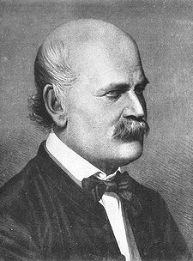
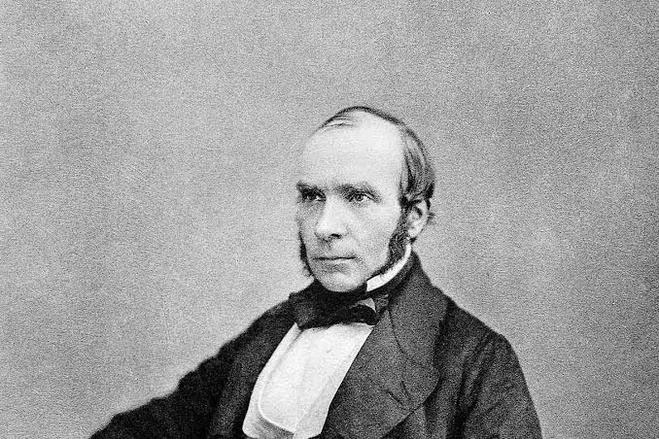
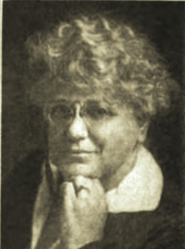
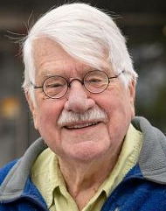
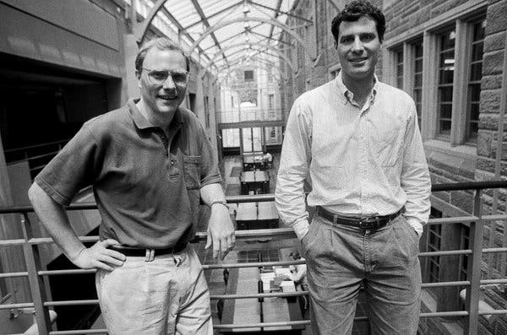
Short story of the long history of DiD
Ignaz Semmelweis
(germs→puerperal fever)
John Snow
(germs→cholera)
Marie Louise Obenauer + Bertha van der Neinburg
(minimum wages→
labor substitution)
1846
1855
1915
Some more minimum wage research in the 40s/50s
Orley Ashenfelter
(training→wages)
David Card + Alan Krueger
(minimum wages→employment)
“New” DiD literature:
Diagnose regression issues
Estimators that work with heterogeneity
Robustness methods
Proliferation of regression DiD: “complicated” designs, covariates, clustered standard errors, etc.
1976
1994
~2018

Slide 4
A causal inference blueprint
What do we want to learn?
Knowledge!
Target parameter
How should we interpret our results?
How will we learn about it?
Identifying variation
Identifying assumptions
Estimand
Robustness
What will we do
(specifically) with our data?
Estimator

Slide 5
A difference-in-differences blueprint
What do we want to learn?
Knowledge!
ATT for today (but can
target distributions, too)
How should we interpret our results?
How will we learn about it?
DiD: a treatment changes for
one group but not another
ID assumptions: parallel trends
Estimand: 2x2 (expectations)
Robustness
(not today, but much easier with a clear analysis)
What will we do
(specifically) with our data?
Estimator: 2x2 (means), potentially many
of them and possibly modelling choices with covariates

Slide 6
A difference-in-differences warning
What do we want to learn?
Knowledge!
Never actually says what we want to know (“the” effect)
Can undermine a causal interpretation even with a valid design.
How should we interpret our results?
How will we learn about it?
Hides the ID variation and assumptions, creates an uninterpretable estimand (“negative weights”)
What will we do
(specifically) with our data?
Starting with a convenient estimator (TWFE)

Slide 7
Plan for today
2x2 DiD (two periods, two groups)
Conditioning on covariates
2xT DiD (many periods, two groups)
GxT DiD (staggered binary treatment)
dX2 DiD (continuous treatment)

Slide 8
What do you want to know?

Slide 9

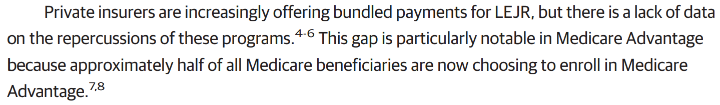

Slide 10
Parameter of interest
A back and forth between questions, data, design, and assumptions
Want:
Can:
Want to study some question: motivation, contribution, etc.
Want a certain interpretation: distributional effects? subgroup effects? external validity?
Want weaker assumptions so focus on certain parameter.
Can only study outcomes, time frames, subgroups you can measure.
Can only reliably estimate what your sample size allows.
Can only use variation that actually occurred.

Slide 11
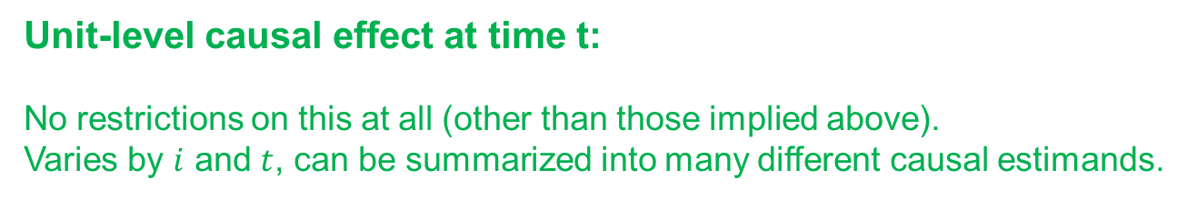
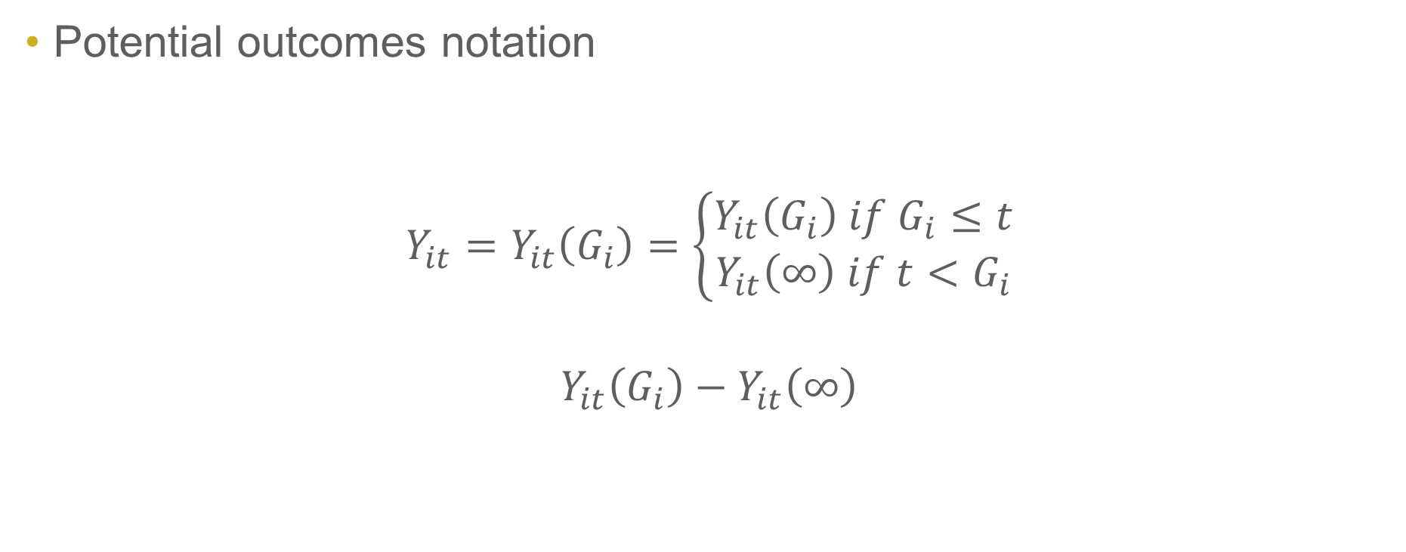
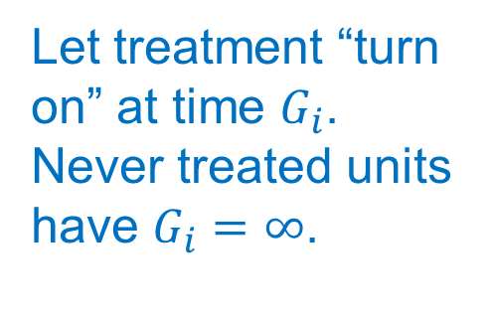
(Causal) parameter of interest
Potential outcomes notation
$$Y_{it}=Y_{it}\left(G_{i}\right)=\left\{\begin{aligned}Y_{it}\left(G_{i}\right) if G_{i}≤t \\ Y_{it}\left(∞\right) if t<G_{i}\end{aligned}\right.$$
$$Y_{it}\left(G_{i}\right)−Y_{it}\left(∞\right)$$
Assumptions embedded in this notation:
SUTVA
No anticipation
Let treatment “turn on” at time $G_{i}$. Never treated units have $G_{i}=∞$.
Unit-level causal effect at time t:
No restrictions on this at all (other than those implied above).
Varies by $i$ and $t$, can be summarized into many different causal estimands.

Slide 12
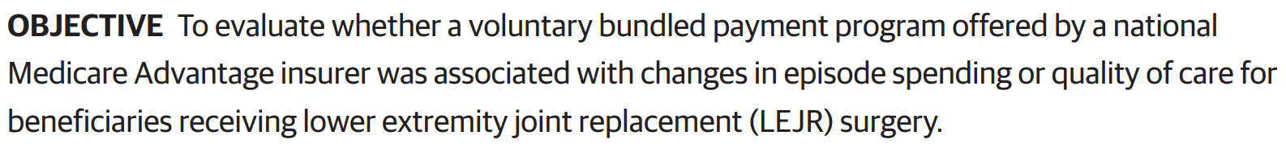

Slide 13

caused
This is a (constrained) choice!
ATE (RCT or strong assumptions)
Distributional effects (data requirements)
Dynamic effects (>2 time periods)
Most DiD targets the ATT:
Average Treatment Effect on the Treated
$$E[Y_{it}\left(G_{i}\right)−Y_{it}\left(∞\right)|G_{i}=g]$$

Slide 14

caused
This is a (constrained) choice!
ATE (RCT or strong assumptions)
Distributional effects (data requirements)
Dynamic effects (>2 time periods)
Most DiD targets the ATT:
Average Treatment Effect on the Treated
$E[Y_{it}\left(G_{i}\right)|G_{i}=g]−E[Y_{it}\left(∞\right)|G_{i}=g]$

Slide 15
What are you willing to believe?

Slide 16
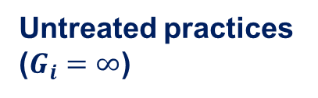
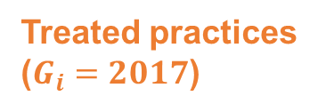
“The” parallel trends assumption (2x2)
Parallel Trends: “mean untreated potential outcomes for treated units would have changed between 2016 and 2018 in the same way as untreated outcomes actually did for untreated units”
Untreated practices
($G_{i}=∞$)
Treated practices
($G_{i}=2017$)

Slide 17
“The” parallel trends assumption (2x2)
Parallel Trends:
$$E\left[Y_{i2018}\left(∞\right) | G_{i}=2017\right]−E\left[Y_{i2016}\left(∞\right) | G_{i}=2017\right]=E\left[Y_{i2018}\left(∞\right) | G_{i}=∞\right]−E\left[Y_{i2017}\left(∞\right) | G_{i}=∞\right]$$
Untreated practices
($G_{i}=∞$)
Treated practices
($G_{i}=2017$)

Slide 18
“The” parallel trends assumption (2x2)
Parallel Trends:
$$E\left[Y_{i2018}\left(∞\right) | G_{i}=2017\right]−E\left[Y_{i2016}\left(∞\right) | G_{i}=2017\right]=E\left[Y_{i2018}\left(∞\right) | G_{i}=∞\right]−E\left[Y_{i2017}\left(∞\right) | G_{i}=∞\right]$$
PT is about pinning down this unobserved counterfactual: mean untreated post-treatment outcomes for treated units
Untreated practices
($G_{i}=∞$)
Treated practices
($G_{i}=2017$)

Slide 19
“The” parallel trends assumption (2x2)
Parallel Trends:
$$E\left[Y_{i2018}\left(∞\right) | G_{i}=2017\right]=E\left[Y_{i2016}\left(∞\right) | G_{i}=2017\right]+E\left[Y_{i2018}\left(∞\right) | G_{i}=∞\right]−E\left[Y_{i2017}\left(∞\right) | G_{i}=∞\right]$$
Untreated practices
($G_{i}=∞$)
Treated practices
($G_{i}=2017$)

Slide 20
What should you actually do?

Slide 21

The 2x2 DiD estimand
Subtract estimated counterfactual from the observed post-treatment outcomes for treated clinics
Untreated practices
($G_{i}=∞$)
Treated practices
($G_{i}=2017$)
$$\hat{ATT}(2018)=−0.023$$

Slide 22
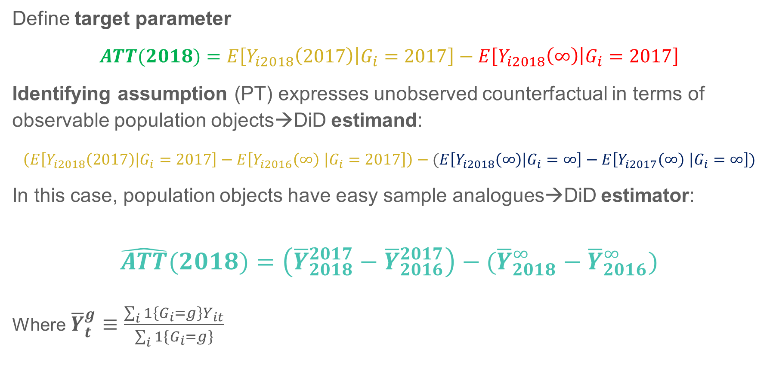
The 2x2 DiD estimand/estimator
Define target parameter
$$ATT(2018)=E\left[Y_{i2018}\left(2017\right) | G_{i}=2017\right]−E\left[Y_{i2018}\left(∞\right) | G_{i}=2017\right]$$
Identifying assumption (PT) expresses unobserved counterfactual in terms of observable population objects→DiD estimand:
$$\left(E\left[Y_{i2018}\left(2017\right) | G_{i}=2017\right]−E\left[Y_{i2016}\left(∞\right) | G_{i}=2017\right]\right)−(E\left[Y_{i2018}\left(∞\right) | G_{i}=∞\right]−E\left[Y_{i2017}\left(∞\right) | G_{i}=∞\right])$$
In this case, population objects have easy sample analogues→DiD estimator:
$$\hat{ATT}(2018)=\left({\overline{Y}}_{2018}^{2017}−{\overline{Y}}_{2016}^{2017}\right)−({\overline{Y}}_{2018}^{∞}−{\overline{Y}}_{2016}^{∞})$$
Where ${\overline{Y}}_{t}^{g}≡\frac{\sum_{i}{1\left\{G_{i}=g\right\}Y_{it}}}{\sum_{i}{1\left\{G_{i}=g\right\}}}$

Slide 23

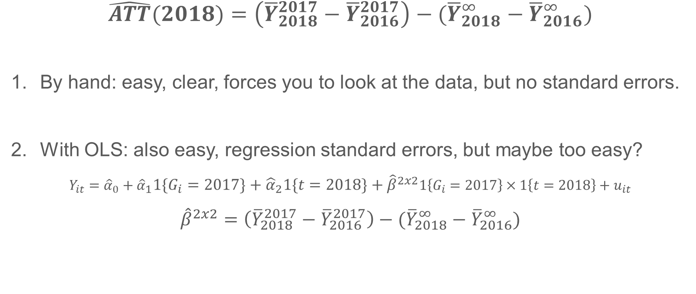
Two ways to get $\hat{ATT}$
$$\hat{ATT}(2018)=\left({\overline{Y}}_{2018}^{2017}−{\overline{Y}}_{2016}^{2017}\right)−({\overline{Y}}_{2018}^{∞}−{\overline{Y}}_{2016}^{∞})$$
By hand: easy, clear, forces you to look at the data, but no standard errors.
With OLS: also easy, regression standard errors, but maybe too easy?
$Y_{it}={\hat{α}}_{0}+{\hat{α}}_{1}1\left\{G_{i}=2017\right\}+{\hat{α}}_{2}1\left\{t=2018\right\}+{\hat{β}}^{2x2}1\left\{G_{i}=2017\right\}×1\left\{t=2018\right\}+u_{it}$
$${\hat{β}}^{2x2}=\left({\overline{Y}}_{2018}^{2017}−{\overline{Y}}_{2016}^{2017}\right)−({\overline{Y}}_{2018}^{∞}−{\overline{Y}}_{2016}^{∞})$$
But is it OK to alter this regression? Multiple periods? Complex treatments? Covariates?
NO (in general)

Slide 24
Covariates (OLS)

Slide 25
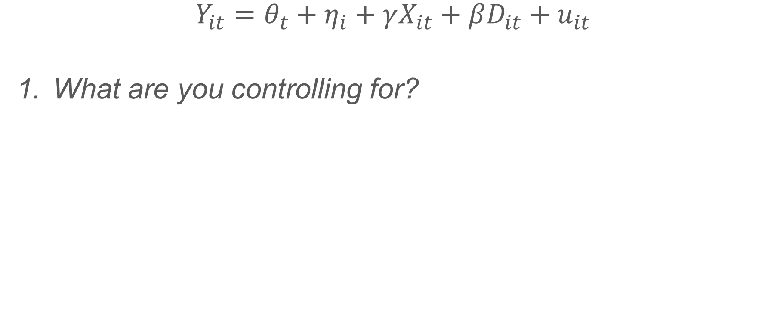
Controlling for things with TWFE
$$Y_{it}=θ_{t}+η_{i}+γX_{it}+βD_{it}+u_{it}$$
What are you controlling for?

Slide 26
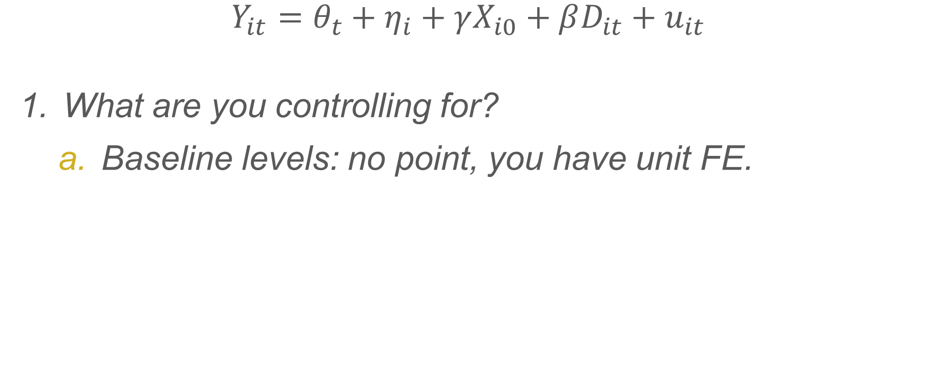
Controlling for things with TWFE
$$Y_{it}=θ_{t}+η_{i}+γX_{i0}+βD_{it}+u_{it}$$
What are you controlling for?
Baseline levels: no point, you have unit FE.

Slide 27
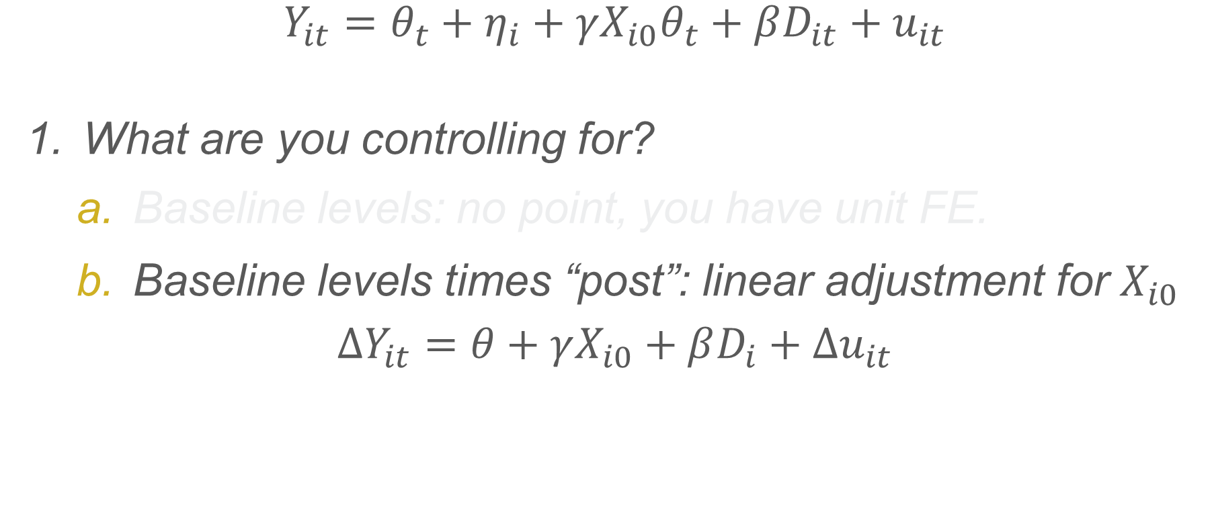
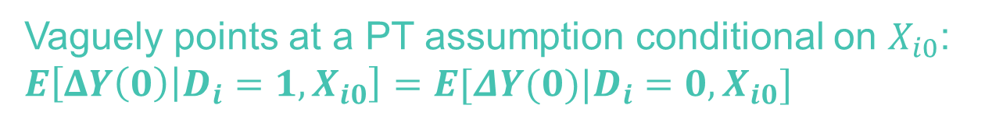
Controlling for things with TWFE
$$Y_{it}=θ_{t}+η_{i}+γX_{i0}θ_{t}+βD_{it}+u_{it}$$
What are you controlling for?
Baseline levels: no point, you have unit FE.
Baseline levels times “post”: linear adjustment for $X_{i0}$
$$ΔY_{it}=θ+γX_{i0}+βD_{i}+Δu_{it}$$
Linear adjustment
(misspecification?)
[Kind of a cheap shot]
Vaguely points at a PT assumption conditional on $X_{i0}$: $E\left[ΔY\left(0\right) | D_{i}=1,X_{i0}\right]=E[ΔY(0)|D_{i}=0,X_{i0}]$
No treatment effect
heterogeneity by X: non-intuitive estimand (Sloczynski 2022)

Slide 28
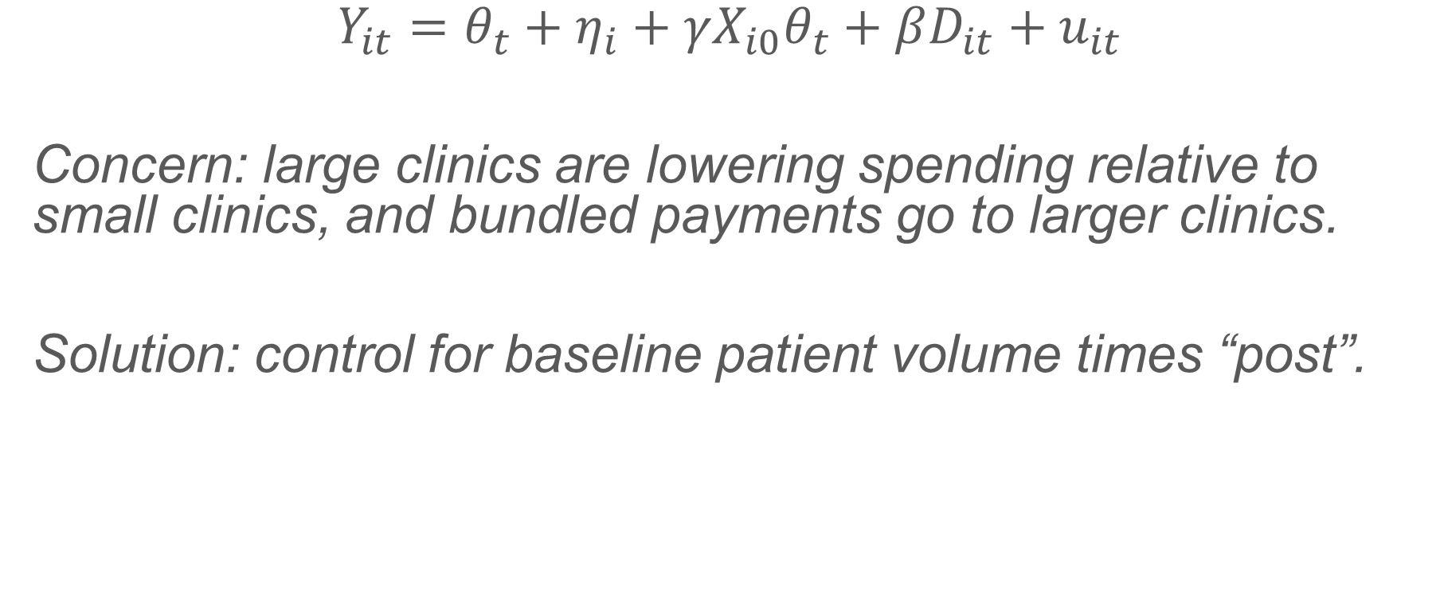
Example: clinic size
$$Y_{it}=θ_{t}+η_{i}+γX_{i0}θ_{t}+βD_{it}+u_{it}$$
Concern: large clinics are lowering spending relative to small clinics, and bundled payments go to larger clinics.
Solution: control for baseline patient volume times “post”.

Slide 29
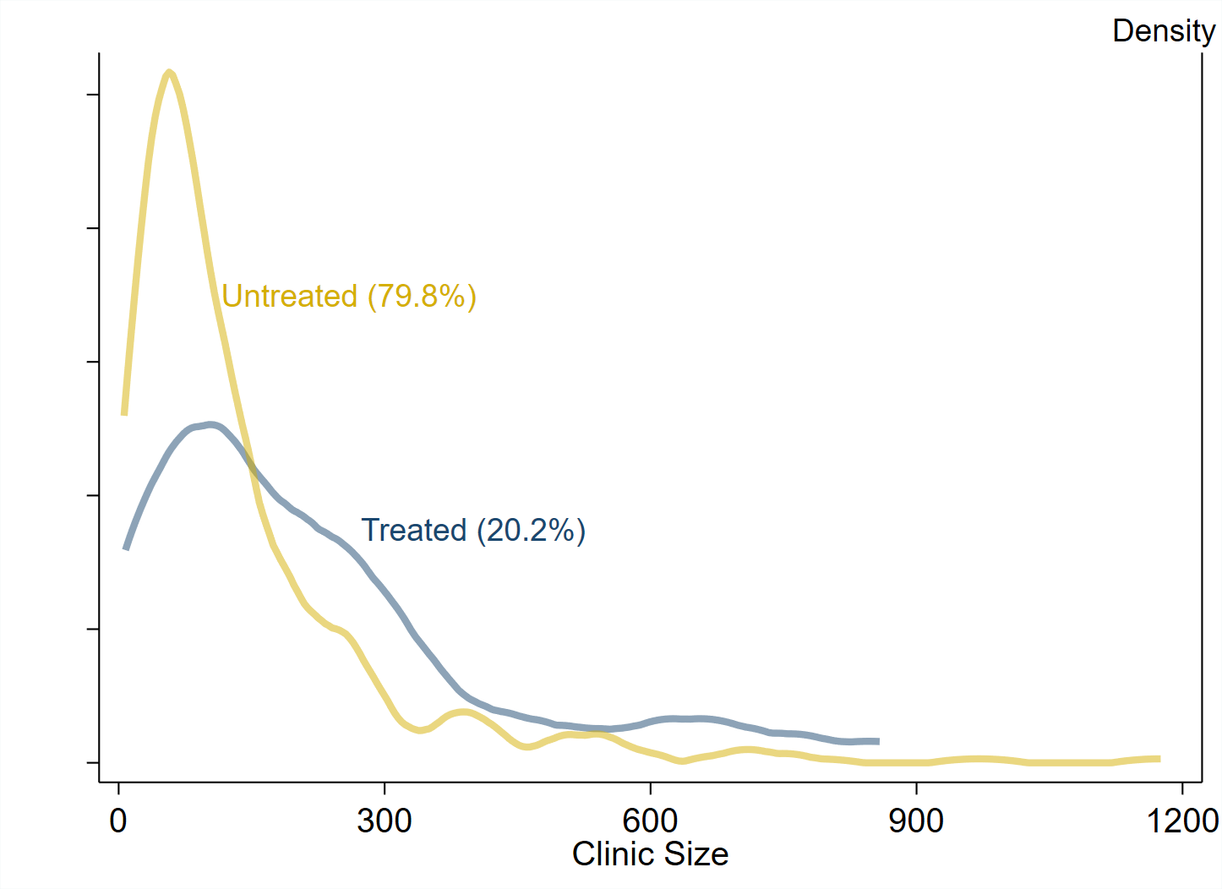

A simulated example with clinic size
Imbalance in ${\overline{X}}_{i0}$ : 87 (225-138)

Slide 30
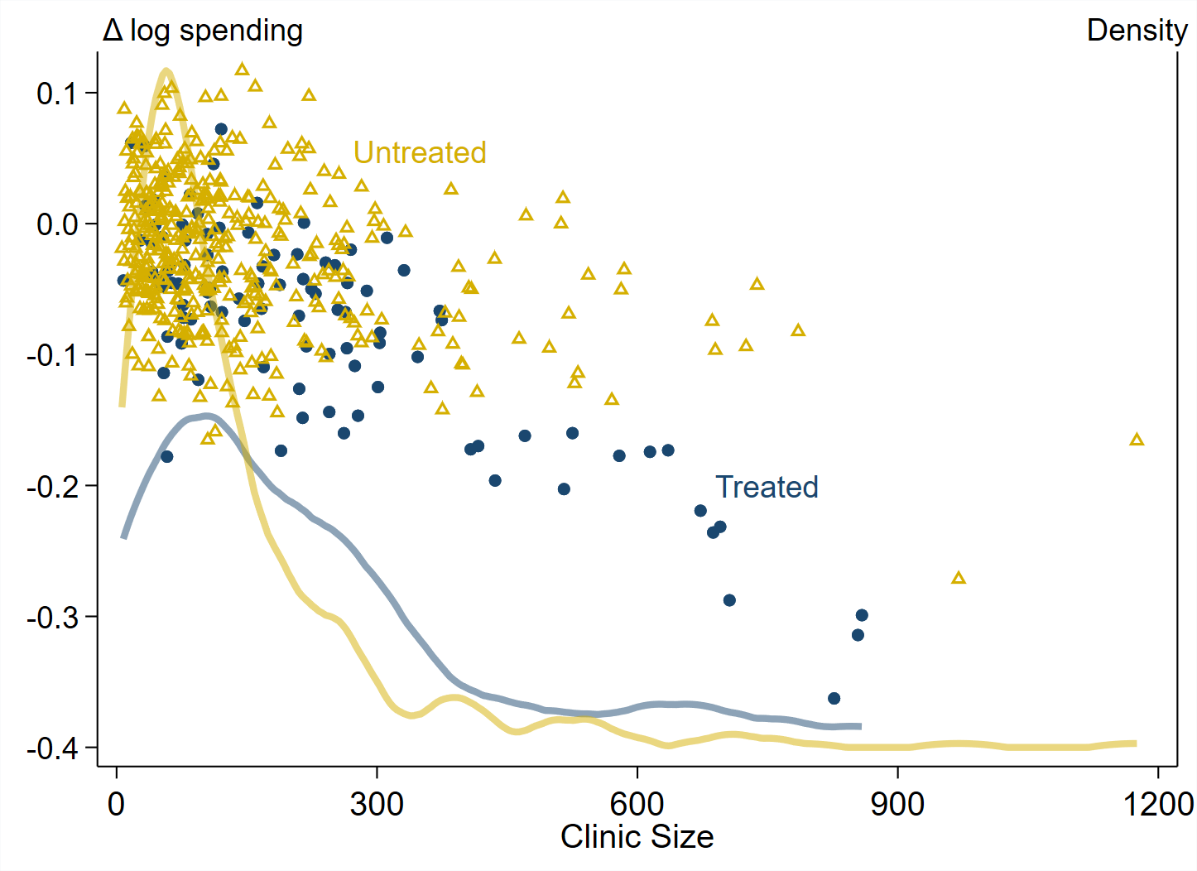
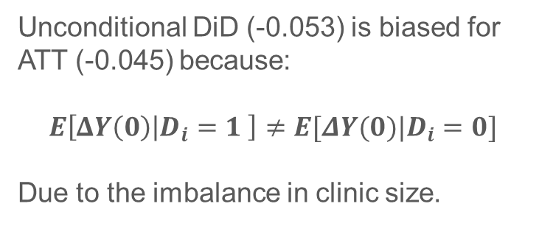
A simulated example with clinic size
Unconditional DiD (-0.053) is biased for ATT (-0.045) because:
$$E\left[ΔY\left(0\right) | D_{i}=1 \right]≠E[ΔY(0)|D_{i}=0]$$
Due to the imbalance in clinic size.

Slide 31
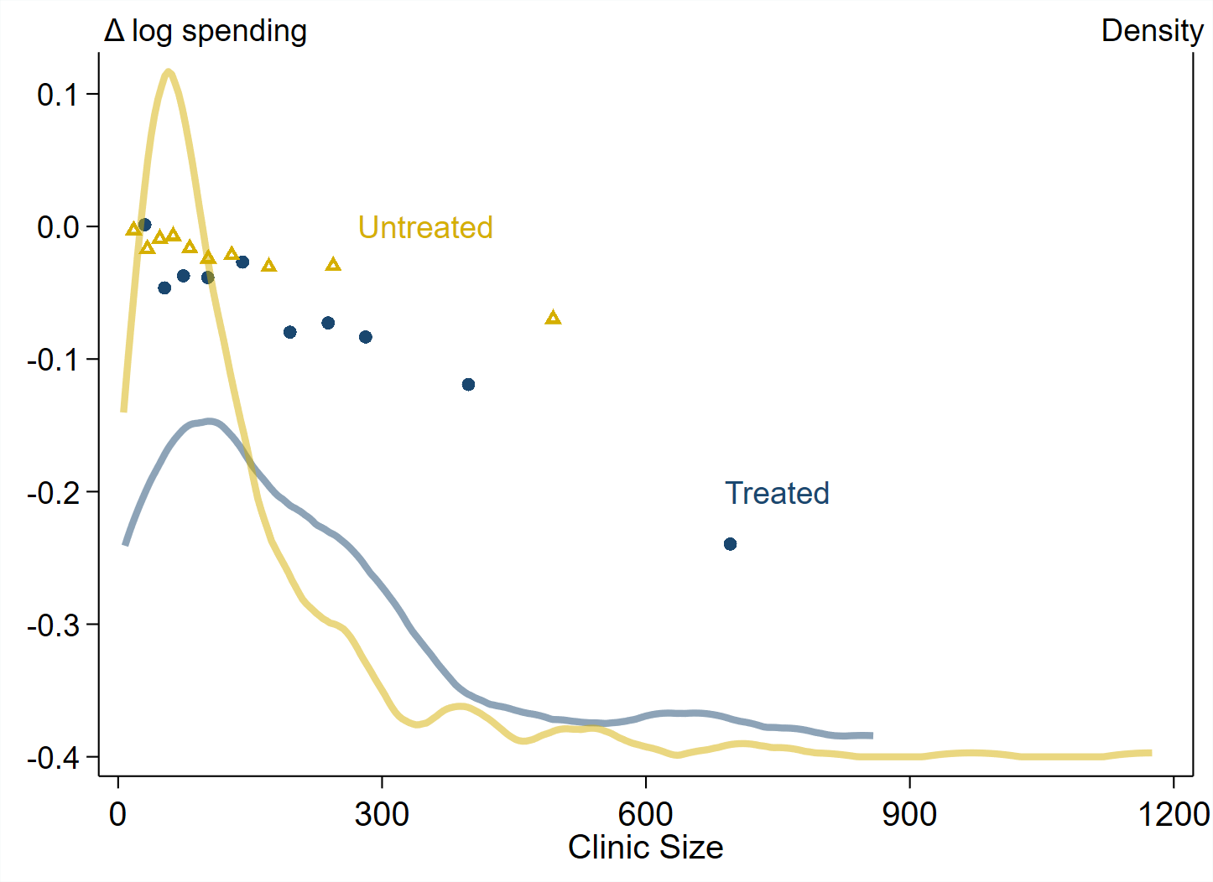
A simulated example with clinic size

Slide 32
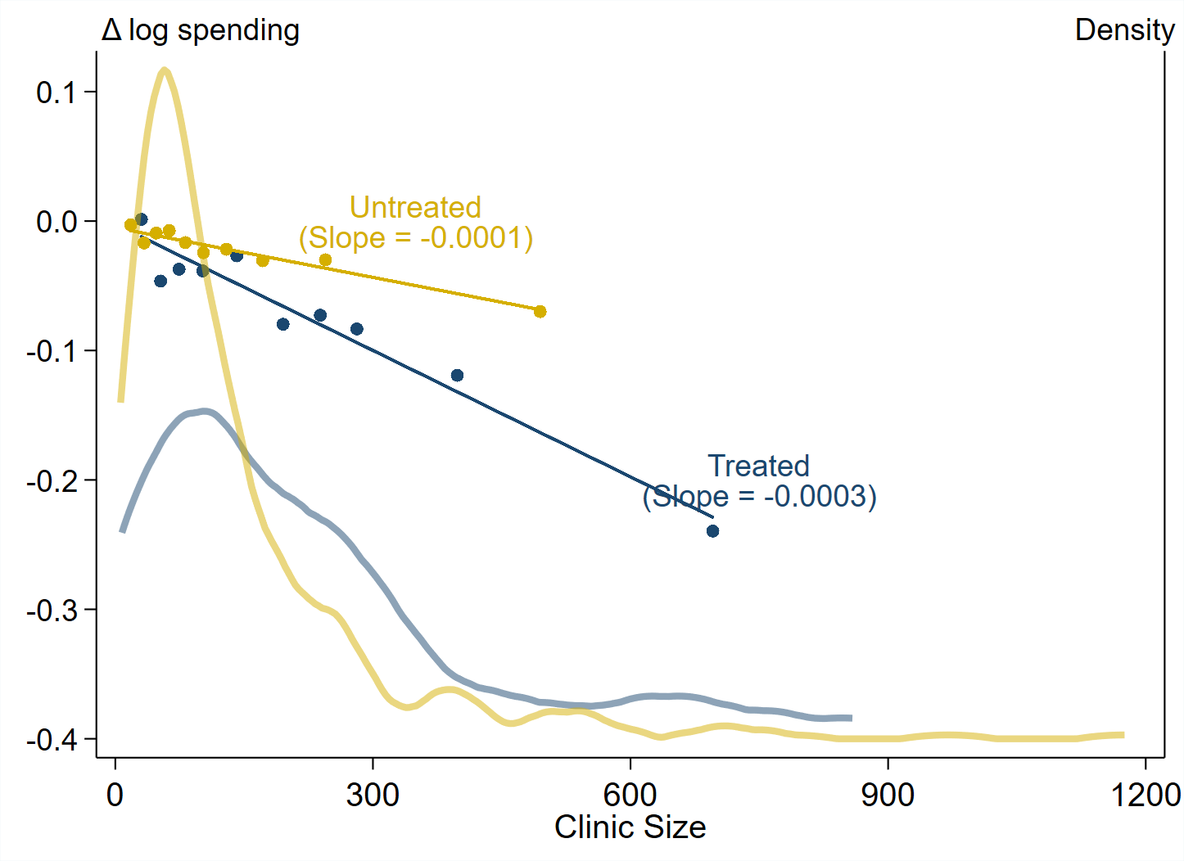
A simulated example with clinic size

Slide 33
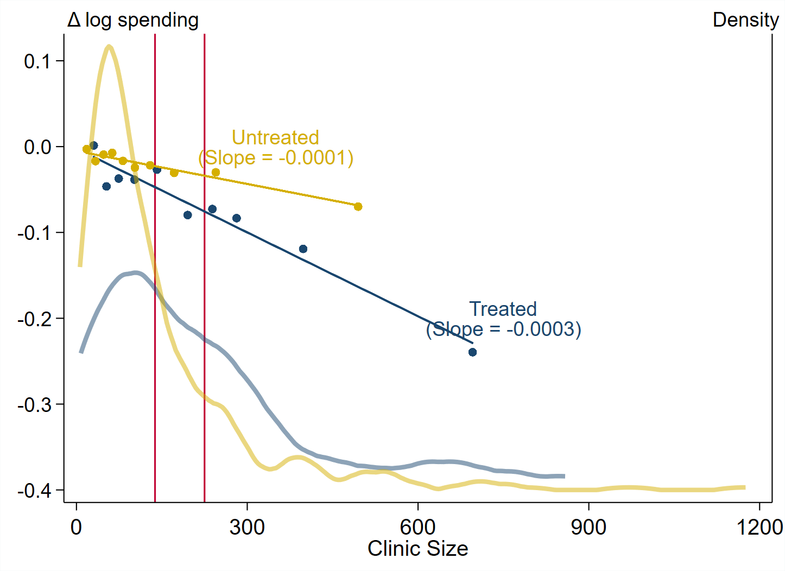

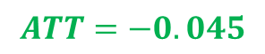
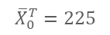
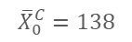
$$ΔY_{it}=θ+γX_{i0}+βD_{i}+Δu_{it}$$
Estimand depends on how one adjusts:
Apply untreated slope to treated X: ATT
Apply treated slope to untreated X: ATU
$$ATU=−0.027$$
$$ATT=−0.045$$
$${\overline{X}}_{0}^{C}=138$$
$${\overline{X}}_{0}^{T}=225$$

Slide 34
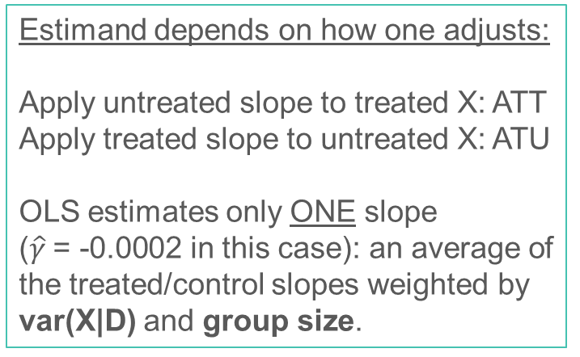
$$ΔY_{it}=θ+γX_{i0}+βD_{i}+Δu_{it}$$
Estimand depends on how one adjusts:
Apply untreated slope to treated X: ATT
Apply treated slope to untreated X: ATU
OLS estimates only ONE slope
($\hat{γ} \text{= −0.0002}$ in this case): an average of the treated/control slopes weighted by var(X|D) and group size.
$${\overline{X}}_{0}^{C}=138$$
$${\overline{X}}_{0}^{T}=225$$

Slide 35
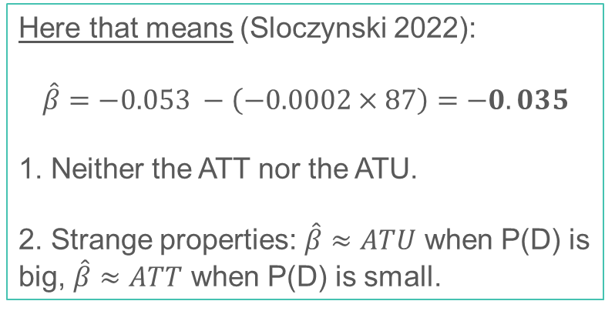
$$ΔY_{it}=θ+γX_{i0}+βD_{i}+Δu_{it}$$
Here that means (Sloczynski 2022):
$$\hat{β}=−0.053 −\left(−0.0002×87\right)=−0.035$$
1. Neither the ATT nor the ATU.
2. Strange properties: $\hat{β}≈ATU$ when P(D) is big, $\hat{β}≈ATT$ when P(D) is small.
$${\overline{X}}_{0}^{C}=138$$
$${\overline{X}}_{0}^{T}=225$$

Slide 36
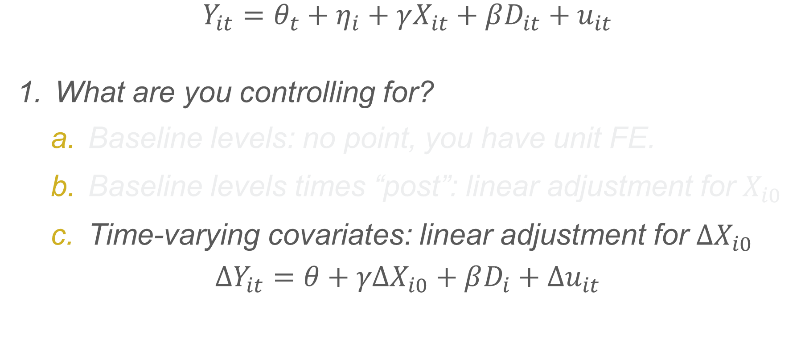
Controlling for things with TWFE
$$Y_{it}=θ_{t}+η_{i}+γX_{it}+βD_{it}+u_{it}$$
What are you controlling for?
Baseline levels: no point, you have unit FE.
Baseline levels times “post”: linear adjustment for $X_{i0}$
Time-varying covariates: linear adjustment for $ΔX_{i0}$
$$ΔY_{it}=θ+γΔX_{i0}+βD_{i}+Δu_{it}$$

Slide 37
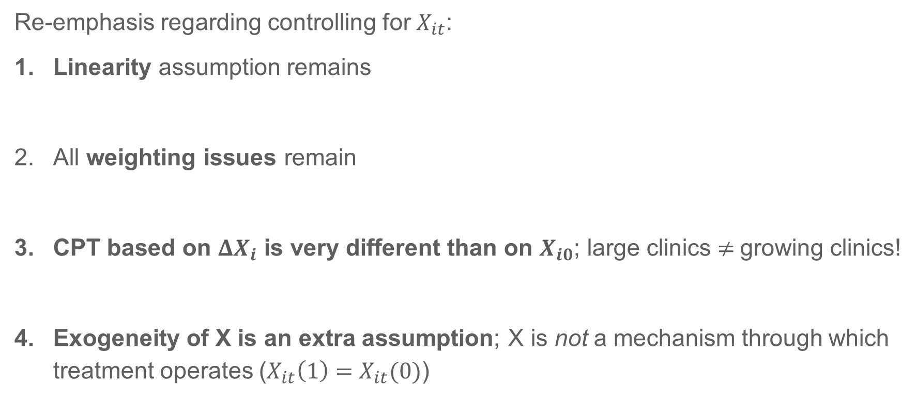
$$ΔY_{it}=θ+γΔX_{i}+βD_{i}+Δu_{it}$$
Re-emphasis regarding controlling for $X_{it}$:
Linearity assumption remains
All weighting issues remain
CPT based on $ΔX_{i}$ is very different than on $X_{i0}$; large clinics $≠$growing clinics!
Exogeneity of X is an extra assumption; X is not a mechanism through which treatment operates ($X_{it}\left(1\right)=X_{it}(0)$)

Slide 38
Covariates (alternative estimators)

Slide 39
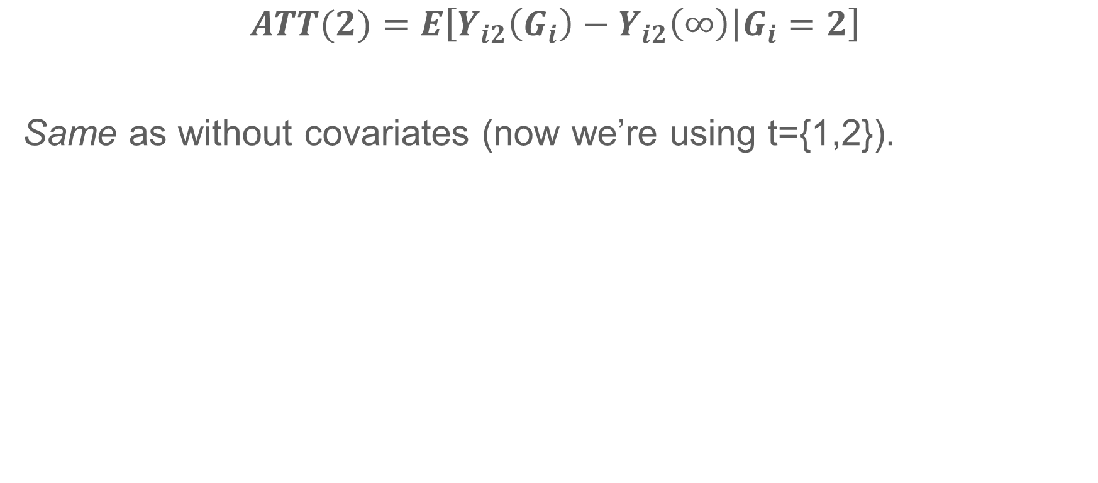
Target parameter
$$ATT(2)=E\left[Y_{i2}\left(G_{i}\right)−Y_{i2}\left(∞\right) | G_{i}=2\right]$$
Same as without covariates (now we’re using t={1,2}).

Slide 40
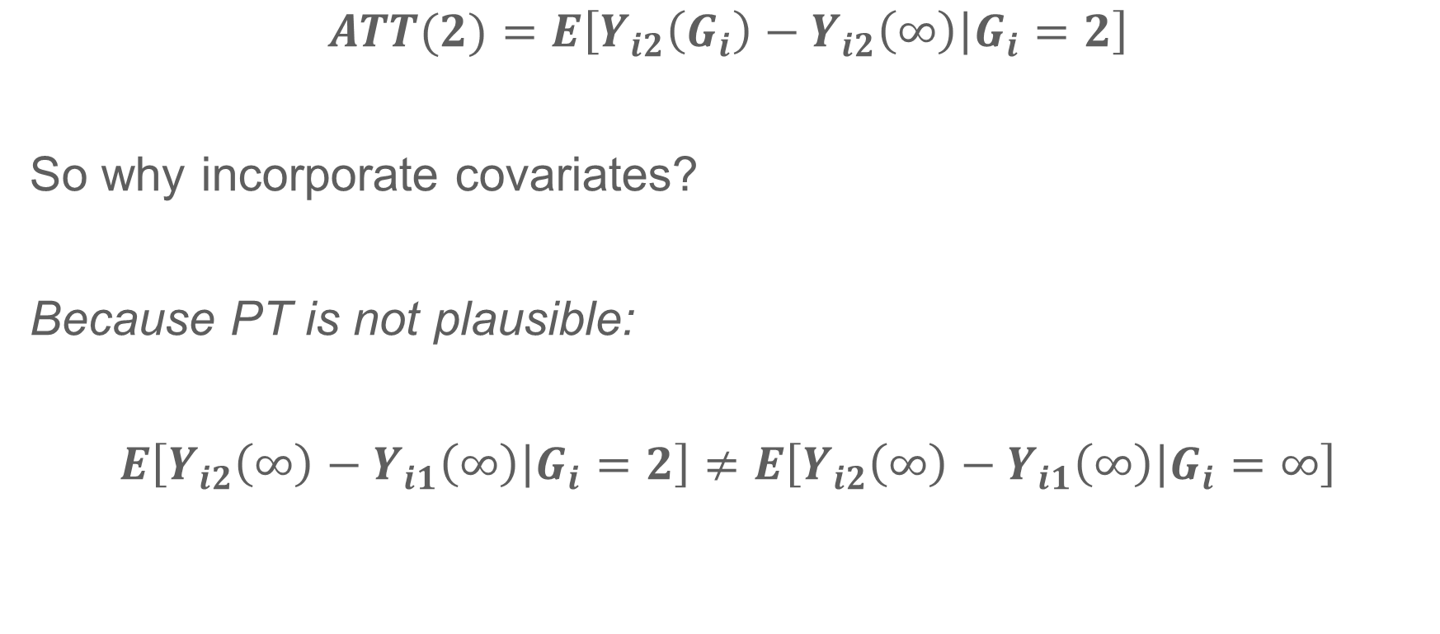
Identifying assumption (not PT)
$$ATT(2)=E\left[Y_{i2}\left(G_{i}\right)−Y_{i2}\left(∞\right) | G_{i}=2\right]$$
So why incorporate covariates?
Because PT is not plausible:
$$E\left[Y_{i2}\left(∞\right)−Y_{i1}\left(∞\right) | G_{i}=2\right]≠E\left[Y_{i2}\left(∞\right)−Y_{i1}\left(∞\right) | G_{i}=∞\right]$$
*Note: if we don’t believe PT then we can’t go through the simple steps from before to derive a 2x2 DiD estimator.

Slide 41
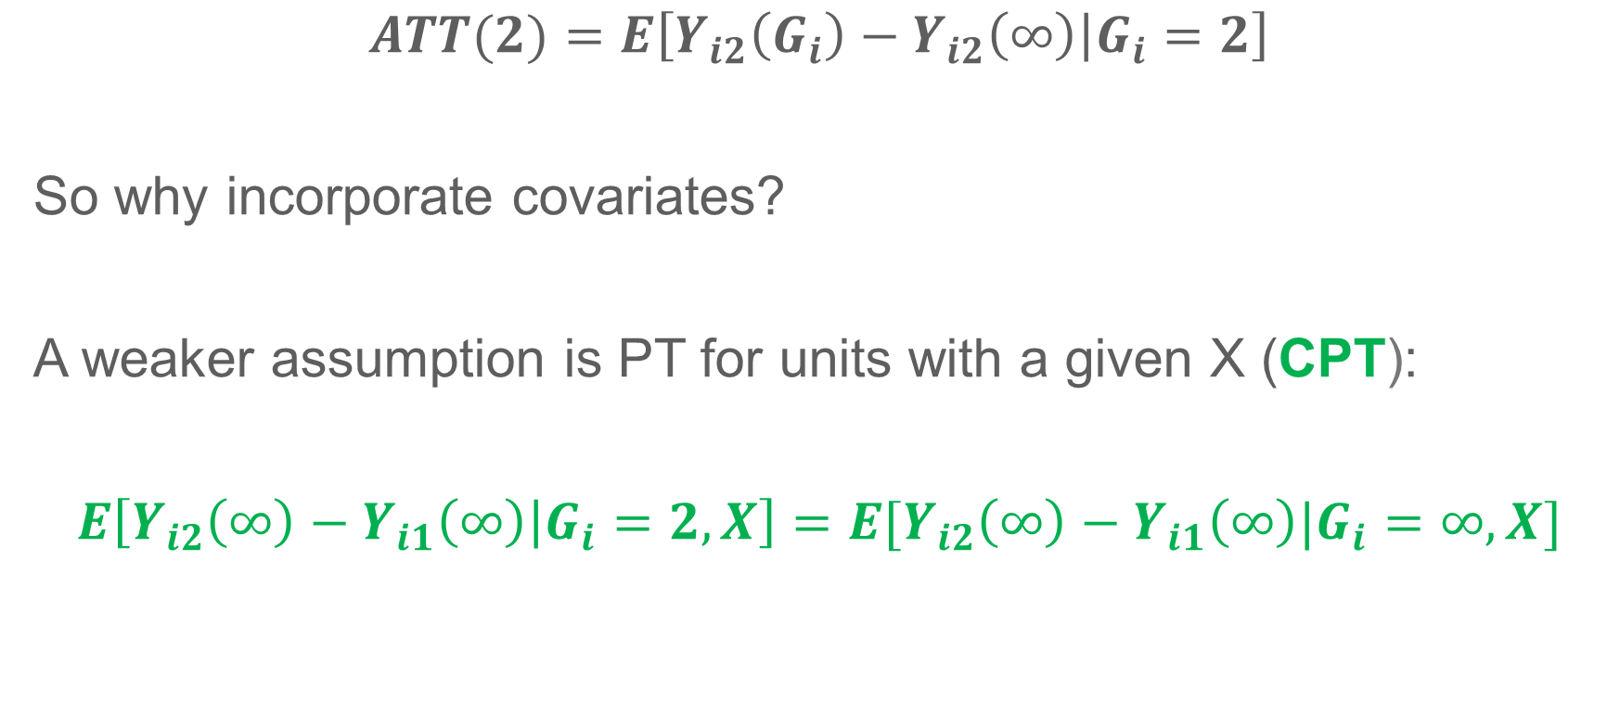
Identifying assumption: Conditional PT
$$ATT(2)=E\left[Y_{i2}\left(G_{i}\right)−Y_{i2}\left(∞\right) | G_{i}=2\right]$$
So why incorporate covariates?
A weaker assumption is PT for units with a given X (CPT):
$$E\left[Y_{i2}\left(∞\right)−Y_{i1}\left(∞\right) | G_{i}=2,X\right]=E[Y_{i2}\left(∞\right)−Y_{i1}\left(∞\right)|G_{i}=∞,X]$$
*Alternate way to write PT in terms of conditional trends:
$$E\left[E[ΔY\left(∞\right)|G_{i}=g,X] | G_{i}=g\right]≠E\left[E\left[ΔY\left(∞\right) | G_{i}=∞,X\right] | G_{i}=∞\right]$$
We can have CPT but not PT if (a) trends vary by X (but are equal across G) and (b) X is imbalanced across groups.

Slide 42
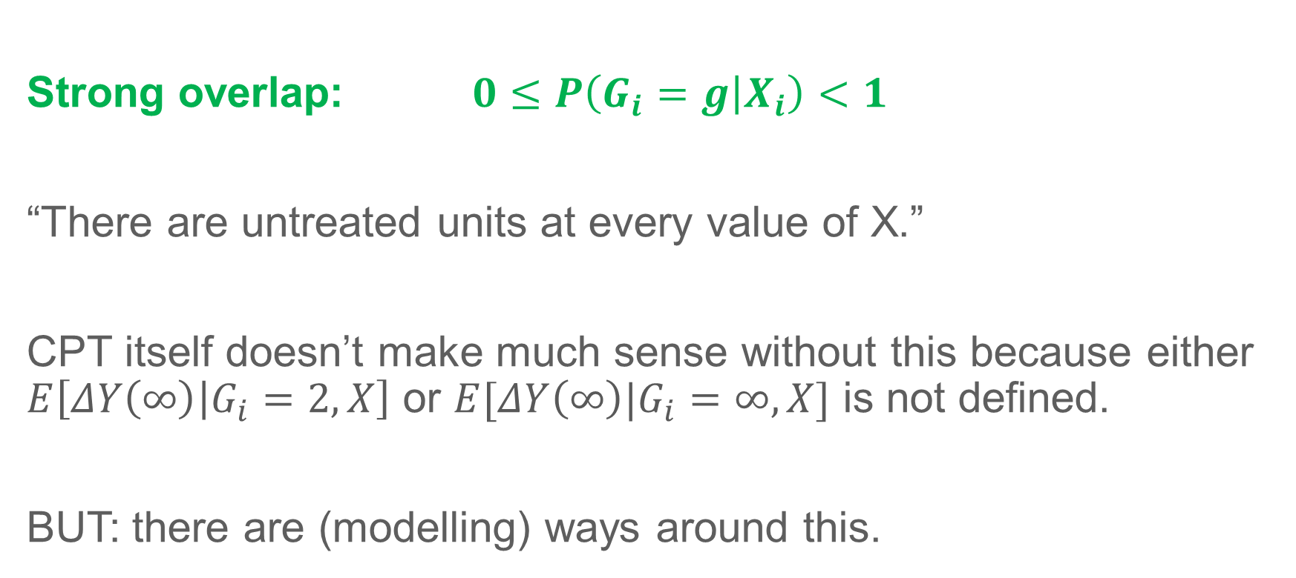
Identifying assumption: SO
Strong overlap: $0≤P\left(G_{i}=g | X_{i}\right)<1$
“There are untreated units at every value of X.”
CPT itself doesn’t make much sense without this because either $E\left[ΔY\left(∞\right) | G_{i}=2,X\right]$ or $E[ΔY\left(∞\right)|G_{i}=∞,X]$ is not defined.
BUT: there are (modelling) ways around this.

Slide 43
Technically SO failed here

Slide 44
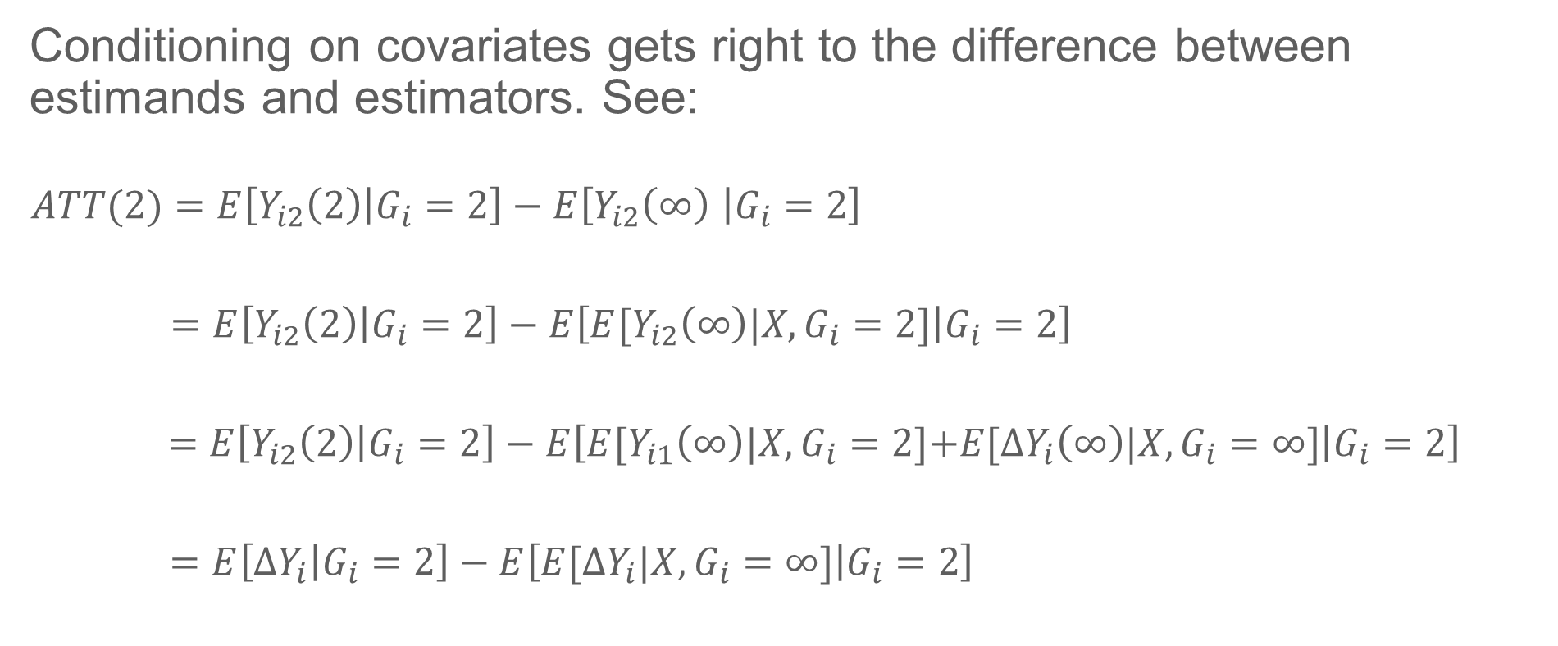
Identification under CPT (Estimand)
Conditioning on covariates gets right to the difference between estimands and estimators. See:
$$ATT(2)=E\left[Y_{i2}\left(2\right) | G_{i}=2\right]−E\left[Y_{i2}\left(∞\right) | G_{i}=2\right]$$
$$=E\left[Y_{i2}\left(2\right) | G_{i}=2\right]−E\left[E[Y_{i2}\left(∞\right)\text{|}X,G_{i}=2\text{]} | G_{i}=2\right]$$
$$=E\left[Y_{i2}\left(2\right) | G_{i}=2\right]−E\left[E[Y_{i1}\left(∞\right)\text{|}X,G_{i}=2\text{]}\text{+}E[ΔY_{i}\left(∞\right)\text{|}X,G_{i}=∞\text{]} | G_{i}=2\right]$$
$$=E\left[ΔY_{i} | G_{i}=2\right]−E\left[E[ΔY_{i}\text{|}X,G_{i}=∞\text{]} | G_{i}=2\right]$$
Law of iterated expectations
Conditional parallel trends
Sub observed outcomes for potential outcomes
This is a conditional DiD ESTIMAND: all observable population quantities

Slide 45
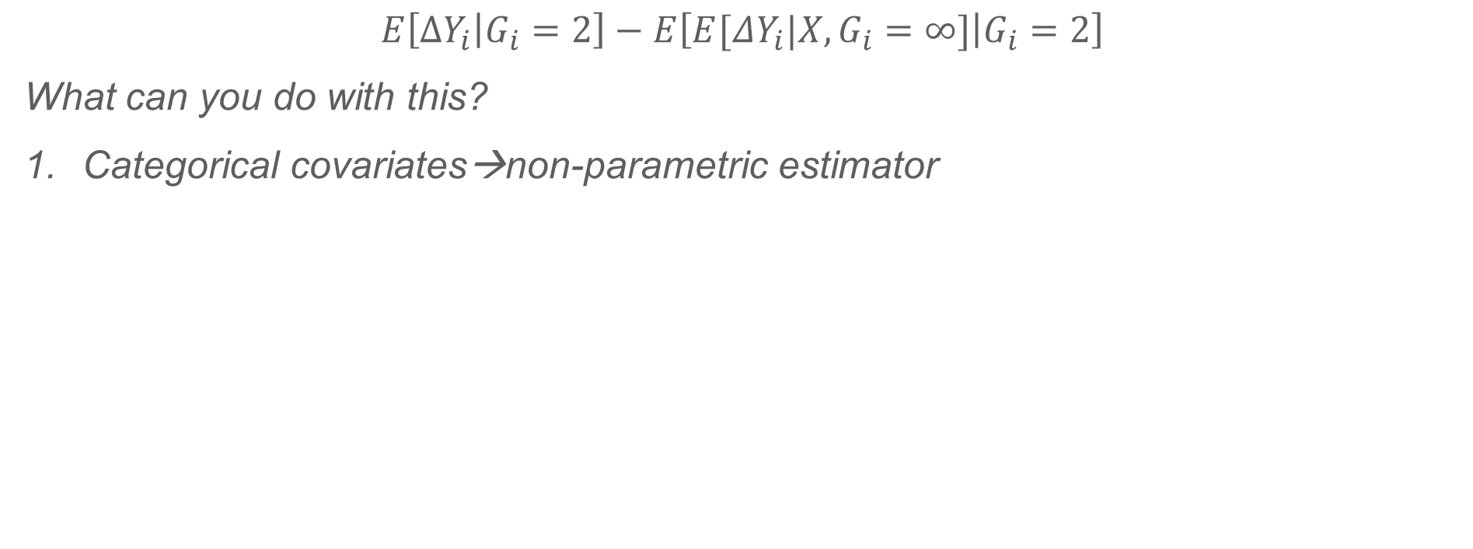
What should you actually do? (Estimator)
$$E\left[ΔY_{i} | G_{i}=2\right]−E\left[E[ΔY_{i}\text{|}X,G_{i}=∞\text{]} | G_{i}=2\right]$$
What can you do with this?
Categorical covariates→non-parametric estimator

Slide 46
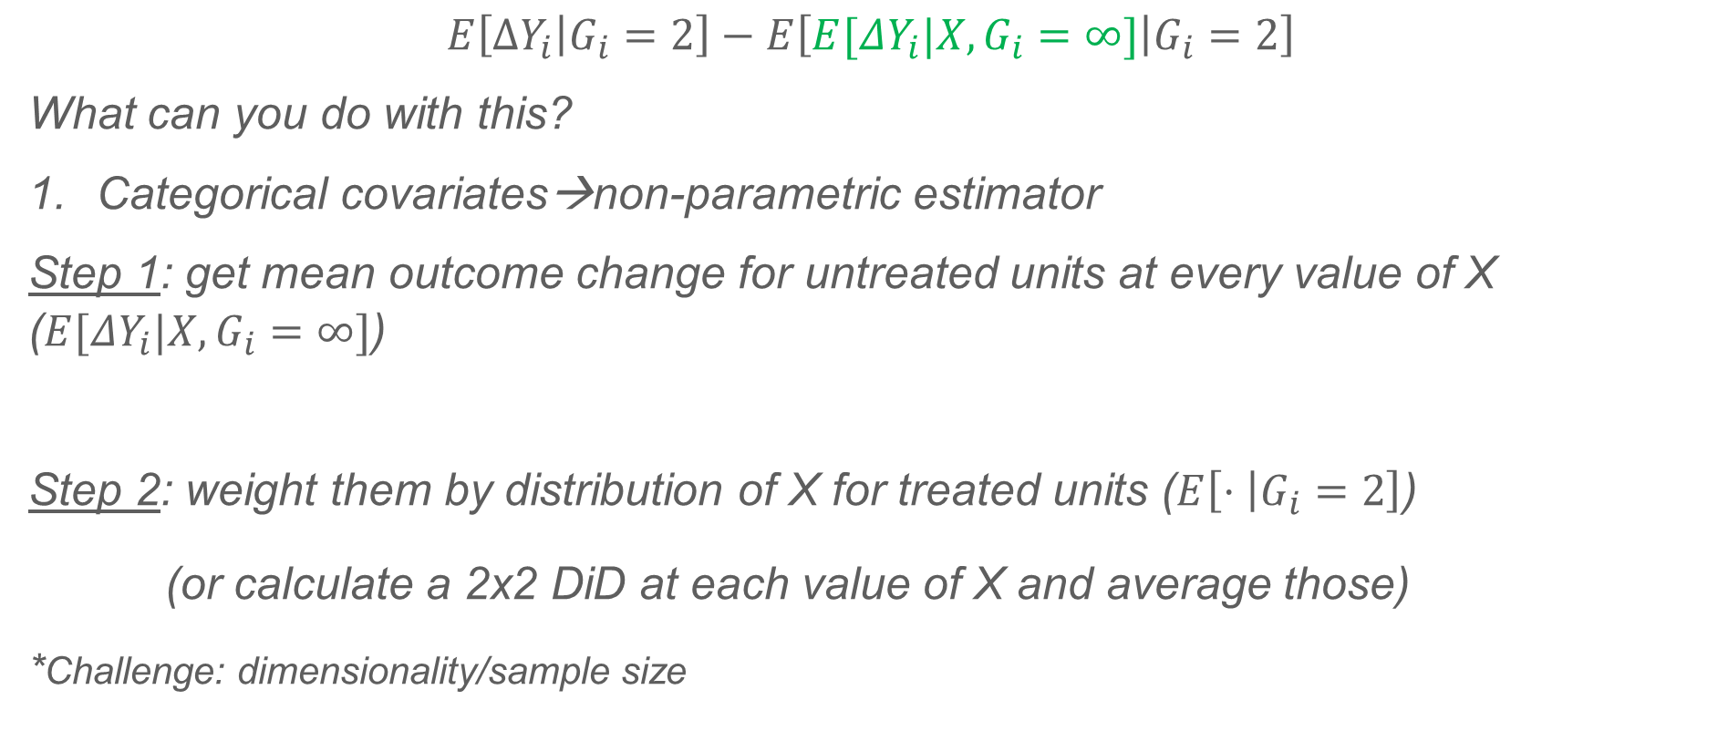
What should you actually do? (Estimator)
$$E\left[ΔY_{i} | G_{i}=2\right]−E\left[E[ΔY_{i}\text{|}X,G_{i}=∞\text{]} | G_{i}=2\right]$$
What can you do with this?
Categorical covariates→non-parametric estimator
Step 1: get mean outcome change for untreated units at every value of X ($E[ΔY_{i}\text{|}X,G_{i}=∞\text{]}$)
Step 2: weight them by distribution of X for treated units ($E\left[⋅ | G_{i}=2\right]$)
(or calculate a 2x2 DiD at each value of X and average those)
*Challenge: dimensionality/sample size

Slide 47
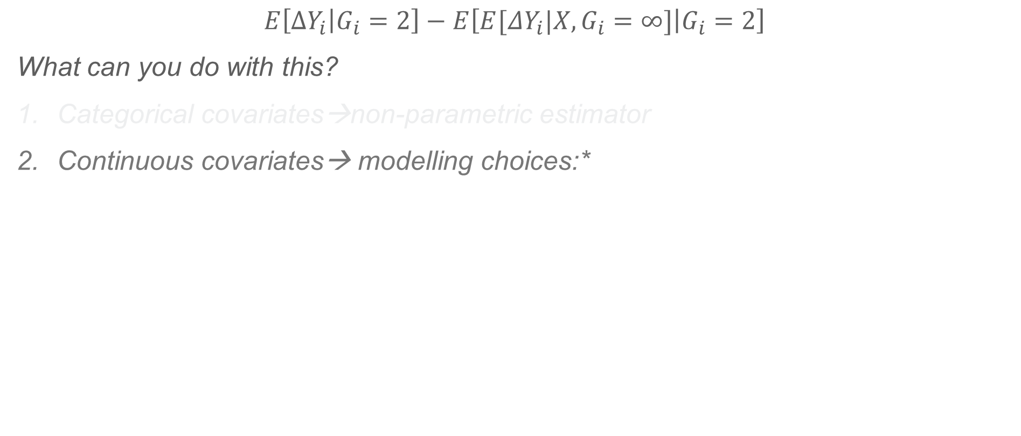
What should you actually do? (Estimator)
$$E\left[ΔY_{i} | G_{i}=2\right]−E\left[E[ΔY_{i}\text{|}X,G_{i}=∞\text{]} | G_{i}=2\right]$$
What can you do with this?
Categorical covariates→non-parametric estimator
Continuous covariates→ modelling choices:*
* b/c actually calculating $E[ΔY_{i}\text{|}X,G_{i}=∞\text{]}$ may be impossible. Estimand has no feasible analog in the sample.

Slide 48
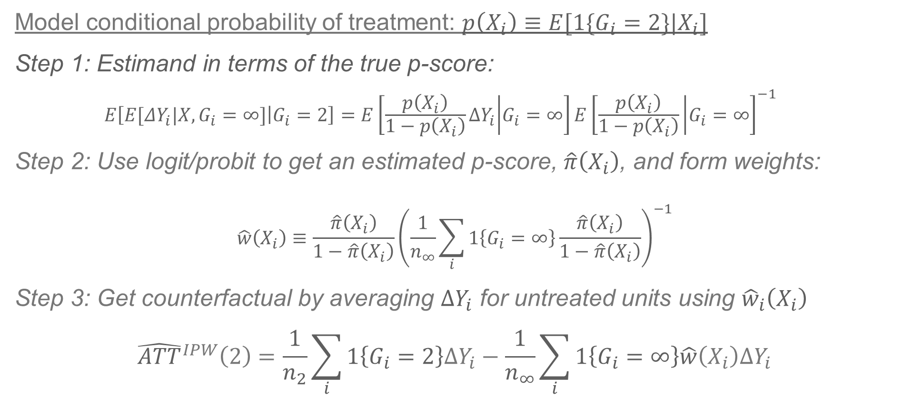
What should you actually do? (IPW)
Model conditional probability of treatment: $p\left(X_{i}\right)≡E[1\{G_{i}=2\}|X_{i}]$
Step 1: Estimand in terms of the true p-score:
$$E\left[E[ΔY_{i}\text{|}X,G_{i}=∞\text{]} | G_{i}=2\right]=E\left[\frac{p\left(X_{i}\right)}{1−p\left(X_{i}\right)}ΔY_{i} | G_{i}=∞\right]E{\left[\frac{p\left(X_{i}\right)}{1−p\left(X_{i}\right)} | G_{i}=∞\right]}^{−1}$$
Step 2: Use logit/probit to get an estimated p-score, $\hat{π}\left(X_{i}\right)$, and form weights:
$$\hat{w}\left(X_{i}\right)≡\frac{\hat{π}\left(X_{i}\right)}{1−\hat{π}\left(X_{i}\right)}{\left(\frac{1}{n_{∞}}\sum_{i}{1\left\{G_{i}=∞\right\}\frac{\hat{π}\left(X_{i}\right)}{1−\hat{π}\left(X_{i}\right)}}\right)}^{−1}$$
Step 3: Get counterfactual by averaging $ΔY_{i}$ for untreated units using ${\hat{w}}_{i}\left(X_{i}\right)$
$${\hat{ATT}}^{IPW}\left(2\right)=\frac{1}{n_{2}}\sum_{i}{1\left\{G_{i}=2\right\}ΔY_{i}}−\frac{1}{n_{∞}}\sum_{i}{1\left\{G_{i}=∞\right\}\hat{w}\left(X_{i}\right)ΔY_{i}}$$
Weighted expectation of outcomes, not conditional-on-X expectations
Dimension reduction!
(Abadie 2005, Sant’Anna and Zhao 2020)

Slide 49
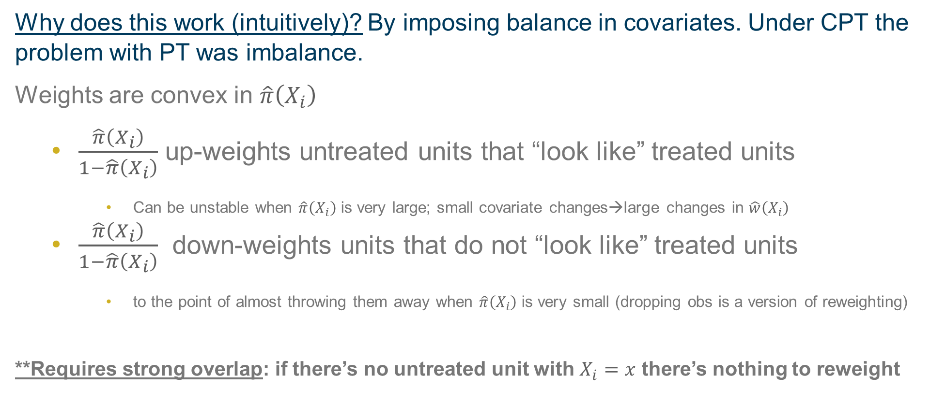
What should you actually do? (IPW)
Why does this work (intuitively)? By imposing balance in covariates. Under CPT the problem with PT was imbalance.
Weights are convex in $\hat{π}\left(X_{i}\right)$
$\frac{\hat{π}\left(X_{i}\right)}{1−\hat{π}\left(X_{i}\right)}$ up-weights untreated units that “look like” treated units
Can be unstable when $\hat{π}\left(X_{i}\right)$ is very large; small covariate changes→large changes in $\hat{w}\left(X_{i}\right)$
$\frac{\hat{π}\left(X_{i}\right)}{1−\hat{π}\left(X_{i}\right)}$ down-weights units that do not “look like” treated units
to the point of almost throwing them away when $\hat{π}\left(X_{i}\right)$ is very small (dropping obs is a version of reweighting)
**Requires strong overlap: if there’s no untreated unit with $X_{i}=x$ there’s nothing to reweight

Slide 50
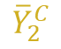
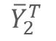
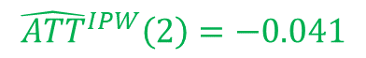
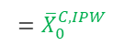
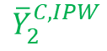
$${\hat{ATT}}^{IPW}(2)$$
Less weight here
More weight here
-0.053; biased by imbalance in clinic size
$${\overline{Y}}_{2}^{C}$$
$${\overline{Y}}_{2}^{C,IPW}$$
$${\hat{ATT}}^{IPW}\left(2\right)=−0.041$$
$${\overline{Y}}_{2}^{T}$$
$${\overline{X}}_{0}^{C}=138$$
$${\overline{X}}_{0}^{T}=225$$
$$={\overline{X}}_{0}^{C,IPW}$$

Slide 51
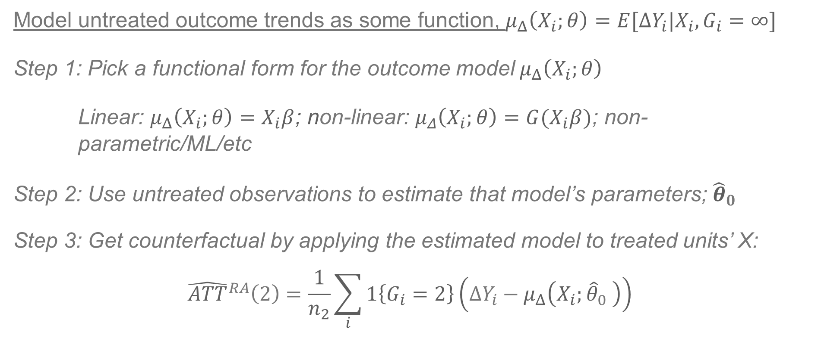
What should you actually do? (RA)
Model untreated outcome trends as some function, $μ_{Δ}\left(X_{i};θ\right)=E[ΔY_{i}|X_{i},G_{i}=∞]$
Step 1: Pick a functional form for the outcome model$μ_{Δ}\left(X_{i};θ\right)$
Linear: $μ_{Δ}\left(X_{i};θ\right)=X_{i}β$; non-linear: $μ_{Δ}\left(X_{i};θ\right)=G(X_{i}β)$; non- parametric/ML/etc
Step 2: Use untreated observations to estimate that model’s parameters; ${\hat{θ}}_{0}$
Step 3: Get counterfactual by applying the estimated model to treated units’ X:
$${\hat{ATT}}^{RA}\left(2\right)=\frac{1}{n_{2}}\sum_{i}{1\left\{G_{i}=2\right\}\left(ΔY_{i}−μ_{Δ}\left(X_{i};{\hat{θ}}_{0} \right)\right)}$$
Dimension reduction!
(Heckman, Ichimura and Todd 1997, Sant’Anna and Zhao 2020)

Slide 52
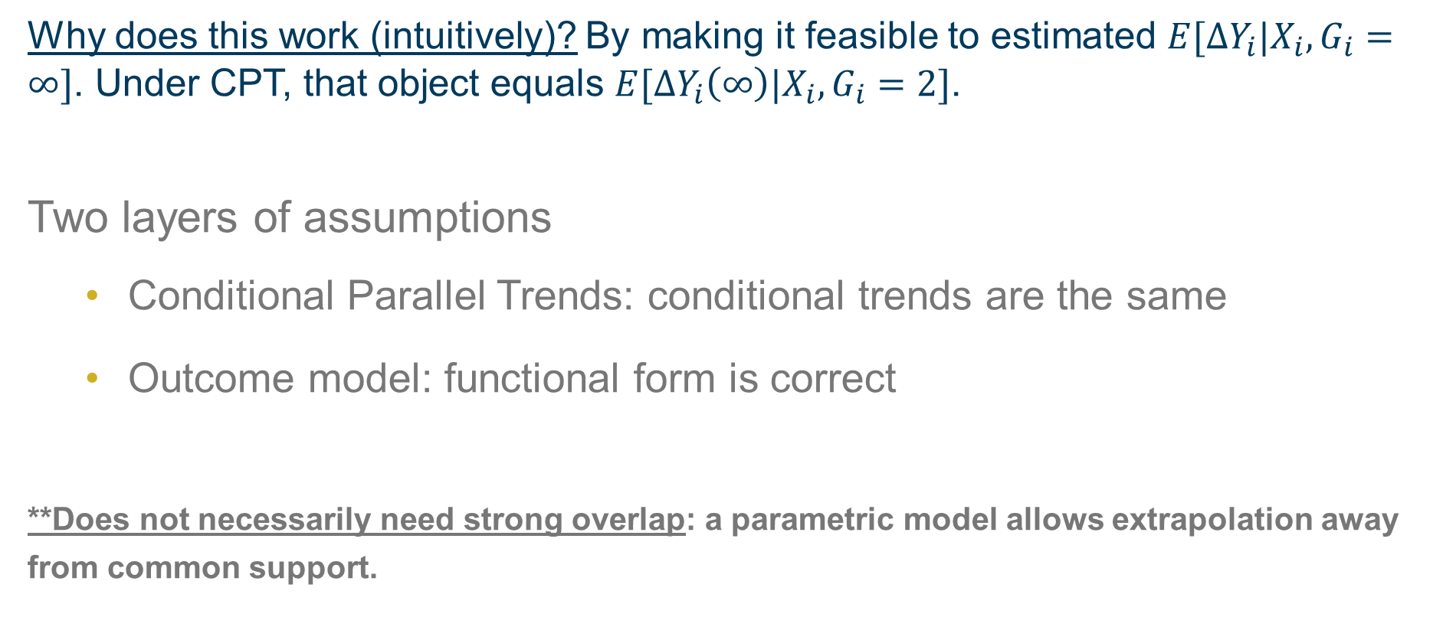
What should you actually do? (RA)
Why does this work (intuitively)? By making it feasible to estimated $E[ΔY_{i}|X_{i},G_{i}=∞]$. Under CPT, that object equals $E[ΔY_{i}\left(∞\right)|X_{i},G_{i}=2]$.
Two layers of assumptions
Conditional Parallel Trends: conditional trends are the same
Outcome model: functional form is correct
**Does not necessarily need strong overlap: a parametric model allows extrapolation away from common support.

Slide 53

$${\hat{ATT}}^{RA}(2)$$
Assumptions
Correct model: Untreated outcome trends really are a linear function of size with a slope of -0.0001.
CPT: Absent treatment, treated clinics would have had outcome changes that also had a slope of -0.0001
$${\hat{ATT}}^{RA}(2)=−0.045$$
$${\overline{X}}_{0}^{C}=138$$
$${\overline{X}}_{0}^{T}=225$$

Slide 54
What should you actually do? (DR)
Can combine both IPW and RA into a doubly robust estimator (Sant’Anna and Zhao 2020)
Omit for today but:
Identifies ATT(2) if either the p-score model OR the outcome model is correct
Double robustness is a property not a specific estimator (eg. Sloczynski and Wooldridge 2018) and there are many ways to do it (ie. Oaxaca-Blinder is doubly robust! [Kline 2011])
teffects/drdid (Stata), did (R)

Slide 55
Staggered Timing

Slide 56
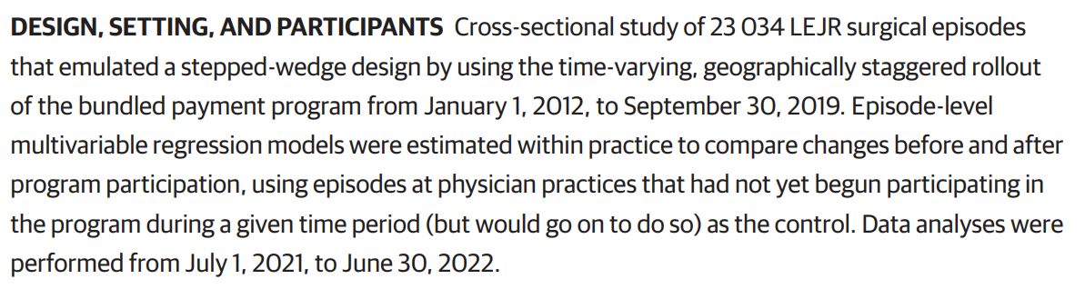

Slide 57


Staggered roll-out

Slide 58

Two-way fixed effects
Suppose $G_{i}$ takes many values; ie. treatment timing varies. This equation doesn’t work anymore:
$$Y_{it}={\hat{α}}_{0}+{\hat{α}}_{1}1\left\{G_{i}=2017\right\}+{\hat{α}}_{2}1\left\{t=2018\right\}+{\hat{β}}^{2x2}1\left\{G_{i}=2017\right\}×1\left\{t=2018\right\}+u_{it}$$
$$y_{it}=α_{i}+α_{t}+{\hat{β}}^{DiD}D_{it}+u_{it}$$
Not just one “treatment group” anymore
“Post” differs across units now
Unit fixed effects
Time fixed effects
Treatment dummy

Slide 59

What is ${\hat{β}}^{DiD}$?

Slide 60

What is ${\hat{β}}^{DiD}$?
$$y_{it}=α_{i}+α_{t}+{\hat{β}}^{DiD}D_{it}+u_{it}$$
1. Partial out fixed effects (Frisch-Waugh):
$${\tilde{D}}_{it}=\left(D_{it}−{\overline{D}}_{i}\right)−\left({\overline{D}}_{t}−\overline{\overline{D}}\right)$$
2. Calculate univariate coefficient by brute force:
${\hat{β}}^{DiD}=\frac{\hat{cov}\left({\tilde{D}}_{it},y_{it}\right)}{\hat{V}\left({\tilde{D}}_{it}\right)}=\frac{\frac{1}{NT}\sum_{i}{\sum_{t}{\left(y_{it}−\overline{\overline{y}}\right)}}\left(\left(D_{it}−{\overline{D}}_{i}\right)−\left({\overline{D}}_{t}−\overline{\overline{D}}\right)\right)}{\frac{1}{NT}\sum_{i}{\sum_{t}{\left(\left(D_{it}−{\overline{D}}_{i}\right)−\left({\overline{D}}_{t}−\overline{\overline{D}}\right)\right)}}}$

Slide 61

${\hat{β}}^{DiD}$?

Slide 62

$${\hat{β}}_{k∞}^{DiD}$$

Slide 63

$${\hat{β}}_{ℓ∞}^{DiD}$$

Slide 64

${\hat{β}}_{kℓ}^{DiD,k}$
Treatment
Control

Slide 65

${\hat{β}}_{kℓ}^{DiD,ℓ}$
Control
Treatment

Slide 66


What is ${\hat{β}}^{DiD}$?
$$y_{it}=α_{i}+α_{t}+{\hat{β}}^{DiD}D_{it}+u_{it}$$
For three groups:
$${\hat{β}}^{DiD}=s_{k∞}{\hat{β}}_{k∞}^{DiD}+s_{ℓ∞}{\hat{β}}_{ℓ∞}^{DiD}+\left[s_{kℓ}^{k}{\hat{β}}_{kℓ}^{DiD,k}+s_{kℓ}^{ℓ}{\hat{β}}_{kℓ}^{DiD,ℓ}\right]$$

Slide 67

What is ${\hat{β}}^{DiD}$?
$$y_{it}=α_{i}+α_{t}+{\hat{β}}^{DiD}D_{it}+u_{it}$$
For three groups:
$${\hat{β}}^{DiD}=s_{k∞}{\hat{β}}_{k∞}^{DiD}+s_{ℓ∞}{\hat{β}}_{ℓ∞}^{DiD}+\left[s_{kℓ}^{k}{\hat{β}}_{kℓ}^{DiD,k}+s_{kℓ}^{ℓ}{\hat{β}}_{kℓ}^{DiD,ℓ}\right]$$

Slide 68

What is ${\hat{β}}^{DiD}$?
$$y_{it}=α_{i}+α_{t}+{\hat{β}}^{DiD}D_{it}+u_{it}$$
For three groups:
$${\hat{β}}^{DiD}=s_{k∞}{\hat{β}}_{k∞}^{DiD}+s_{ℓ∞}{\hat{β}}_{ℓ∞}^{DiD}+\left[s_{kℓ}^{k}{\hat{β}}_{kℓ}^{DiD,k}+s_{kℓ}^{ℓ}{\hat{β}}_{kℓ}^{DiD,ℓ}\right]$$
$$s_{k∞}=\frac{{\left(n_{k}+n_{∞}\right)}^{2}n_{k∞}(1−n_{k∞}){\overline{D}}_{k}\left(1−{\overline{D}}_{k}\right)}{V\left({\tilde{D}}_{it}\right)}$$
$$s_{kℓ}^{k}=\frac{{\left(\left(n_{k}+n_{ℓ}\right)\left(1−{\overline{D}}_{ℓ}\right)\right)}^{2}n_{kℓ}\left(1−n_{kℓ}\right)\frac{{\overline{D}}_{k}−{\overline{D}}_{ℓ}}{1−{\overline{D}}_{ℓ}}\frac{1−{\overline{D}}_{k}}{1−{\overline{D}}_{ℓ}}}{V\left({\tilde{D}}_{it}\right)}$$
$$s_{kℓ}^{ℓ}=\frac{{\left(\left(n_{k}+n_{ℓ}\right){\overline{D}}_{k}\right)}^{2}n_{kℓ}\left(1−n_{kℓ}\right)\frac{{\overline{D}}_{k}−{\overline{D}}_{ℓ}}{{\overline{D}}_{k}}\frac{{\overline{D}}_{ℓ}}{{\overline{D}}_{k}}}{V\left({\tilde{D}}_{it}\right)}$$
Sample size²

Slide 69

What is ${\hat{β}}^{DiD}$?
$$y_{it}=α_{i}+α_{t}+{\hat{β}}^{DiD}D_{it}+u_{it}$$
For three groups:
$${\hat{β}}^{DiD}=s_{kU}{\hat{β}}_{kU}^{DiD}+s_{ℓU}{\hat{β}}_{ℓU}^{DiD}+\left[s_{kℓ}^{k}{\hat{β}}_{kℓ}^{DiD,k}+s_{kℓ}^{ℓ}{\hat{β}}_{kℓ}^{DiD,ℓ}\right]$$
$$s_{k∞}=\frac{{\left(n_{k}+n_{∞}\right)}^{2}n_{k∞}(1−n_{k∞}){\overline{D}}_{k}\left(1−{\overline{D}}_{k}\right)}{V\left({\tilde{D}}_{it}\right)}$$
$$s_{kℓ}^{k}=\frac{{\left(\left(n_{k}+n_{ℓ}\right)\left(1−{\overline{D}}_{ℓ}\right)\right)}^{2}n_{kℓ}\left(1−n_{kℓ}\right)\frac{{\overline{D}}_{k}−{\overline{D}}_{ℓ}}{1−{\overline{D}}_{ℓ}}\frac{1−{\overline{D}}_{k}}{1−{\overline{D}}_{ℓ}}}{V\left({\tilde{D}}_{it}\right)}$$
$$s_{kℓ}^{ℓ}=\frac{{\left(\left(n_{k}+n_{ℓ}\right){\overline{D}}_{k}\right)}^{2}n_{kℓ}\left(1−n_{kℓ}\right)\frac{{\overline{D}}_{k}−{\overline{D}}_{ℓ}}{{\overline{D}}_{k}}\frac{{\overline{D}}_{ℓ}}{{\overline{D}}_{k}}}{V\left({\tilde{D}}_{it}\right)}$$
Subsample
variance of
treatment

Slide 70
Biggest TWFE Problem: Time-Varying Homogeneous Effects
**Sun and Abraham show that a version of this is a problem even for event-study specifications.
This one is fine
**Wooldridge argues this is not a failure of TWFE per se, but of the specification (ie. just add more flexible terms)
This one is not

Slide 71
What does “ATT” mean when there are multiple treated groups?

Slide 72






Group-Time ATTs: $ATT(g,t)$
And for the $g=2018$ group
Timing groups
($G_{i}=g)$
Same for the $g=2017$ group
Mean outcomes for “timing group” $g=2016$
There is an ATT-type parameter for every $t$ in the 2016-group’s post-period
$$(t)$$

Slide 73



Group-Time ATTs: $ATT(g,t)$
$$ATT\left(g,t\right)≡E[Y_{it}\left(g\right)−Y_{it}\left(∞\right)|G_{i}=g]$$
The causal effect on unit $i$ in period $t$ of having been treated at time $g$
Being averaged (again, this is a choice!)
Only over the units who really did get treated at time $g$
“Building block parameter”:
A simple DiD type of ATT parameter with one treatment (time $g$)
and one “post” period (time $t$), averaged over one group (group $g$)

Slide 74
All DiD analyses center on “building blocks”
That is where identification lives and dies (next section)
That is how what you should think about estimating (section after that)
You choose up front what combination of building blocks you want.

Slide 75







Group-Time ATTs: $ATT(g,t)$
$$G_{i}$$
2016
$$ATT(2016,2016)$$
$$ATT(2016,2017)$$
$$ATT(2016,2018)$$
2017
$$ATT(2017,2017)$$
$$ATT(2017,2018)$$
2018
$$ATT(2018,2018)$$
Sample period (t)

Slide 76



Group-Time ATTs: $ATT(g,t)$
$$G_{i}$$
These are the “instantaneous” effects for each timing group
2016
$$ATT(2016,2016)$$
$$ATT(2016,2017)$$
$$ATT(2016,2018)$$
2017
$$ATT(2017,2017)$$
$$ATT(2017,2018)$$
2018
$$ATT(2018,2018)$$
Sample period (t)

Slide 77





Group-Time ATTs: $ATT(g,t)$
These are the “second-year” effects for each timing group, but you can only hope to estimate them for G=2016 and G=2017!
$$G_{i}$$
These are the “instantaneous” effects for each timing group
2016
$$ATT(2016,2016)$$
$$ATT(2016,2017)$$
$$ATT(2016,2018)$$
2017
$$ATT(2017,2017)$$
$$ATT(2017,2018)$$
2018
$$ATT(2018,2018)$$
Sample period (t)

Slide 78



Group-Time ATTs: $ATT(g,t)$
These are the “second-year” effects for each timing group, but you can only hope to estimate them for G=2016 and G=2017!
The “longest run” effect can only be estimated for the earliest group!
$$G_{i}$$
These are the “instantaneous” effects for each timing group
2016
$$ATT(2016,2016)$$
$$ATT(2016,2017)$$
$$ATT(2016,2018)$$
2017
$$ATT(2017,2017)$$
$$ATT(2017,2018)$$
2018
$$ATT(2018,2018)$$
Sample period (t)

Slide 79





Event-Time ATTs: $ATT(e)$
$$G_{i}$$
$$ATT\left(0\right)=\sum_{g=2016}^{2018}{\frac{N_{g}}{N_{treat}}ATT(g,g)}$$
2016
$$ATT(2016,2016)$$
$$ATT(2016,2017)$$
$$ATT(2016,2018)$$
2017
$$ATT(2017,2017)$$
$$ATT(2017,2018)$$
2018
$$ATT(2018,2018)$$
-2
-1
0
1
2
Event-time ($e=t−g$)

Slide 80


Event-Time ATTs: $ATT(e)$
$$ATT\left(1\right)=\sum_{g=2016}^{2017}{\frac{N_{g}}{N_{treat}−N_{2018}}ATT(g,g)}$$
$$G_{i}$$
$$ATT\left(0\right)=\sum_{g=2016}^{2018}{\frac{N_{g}}{N_{treat}}ATT(g,g)}$$
2016
$$ATT(2016,2016)$$
$$ATT(2016,2017)$$
$$ATT(2016,2018)$$
2017
$$ATT(2017,2017)$$
$$ATT(2017,2018)$$
2018
$$ATT(2018,2018)$$
-2
-1
0
1
2
Event-time ($e=t−g$)

Slide 81


Event-Time ATTs: $ATT(e)$
$$ATT\left(1\right)=\sum_{g=2016}^{2017}{\frac{N_{g}}{N_{treat}−N_{2018}}ATT(g,g)}$$
$$G_{i}$$
$$ATT\left(0\right)=\sum_{g=2016}^{2018}{\frac{N_{g}}{N_{treat}}ATT(g,g)}$$
$$ATT\left(2\right)=ATT(2016,2018)$$
2016
$$ATT(2016,2016)$$
$$ATT(2016,2017)$$
$$ATT(2016,2018)$$
2017
$$ATT(2017,2017)$$
$$ATT(2017,2018)$$
2018
$$ATT(2018,2018)$$
-2
-1
0
1
2
Event-time ($e=t−g$)

Slide 82
Overall ATT: $\overline{ATT}$
Or you can average them all, but note that groups contribute different numbers of parameters!
Aggregation matters and it starts with the target parameter you choose!
$$G_{i}$$
2016
$$ATT(2016,2016)$$
$$ATT(2016,2017)$$
$$ATT(2016,2018)$$
2017
$$ATT(2017,2017)$$
$$ATT(2017,2018)$$
2018
$$ATT(2018,2018)$$
-2
-1
0
1
2
Event-time ($e=t−g$)

Slide 83


$$ATT(0)$$
OBJECTIVE To estimate the average first-year treatment effect of a voluntary bundled payment program offered by a national Medicare Advantage insurer on spending among patients receiving lower extremity joint replacement (LEJR) surgery at participating physician practices.
$$\overline{ATT}$$
OBJECTIVE To estimate the average treatment effect of a voluntary bundled payment program offered by a national Medicare Advantage insurer on spending during patient episodes for lower extremity joint replacement (LEJR) surgery at participating physician practices.

Slide 84



Identifying assumption: back to building blocks
We know what we want to know:
$$ATT\left(g,t\right)= E\left[Y_{it}\left(g\right)−Y_{it}\left(∞\right) | G_{i}=g\right]$$
$E\left[Y_{it}\left(g\right) | G_{i}=g\right]−E[Y_{it}(∞)|G_{i}=g]$
Same target as a 2x2 with periods $t$ and $g−1$ and treated group $G_{i}=g$. We know how to identify it under parallel trends!
$$E[Y_{it}(∞)|G_{i}∈𝒢^{comp}]−E\left[Y_{ig−1}\left(∞\right) | G_{i}∈𝒢^{comp}\right]= E\left[Y_{it}\left(∞\right) | G_{i}=g\right]−E\left[Y_{ig−1}\left(∞\right) | G_{i}=g\right]$$
Observed change in mean outcomes
for comparison units from $g−1$ to $t$
Unobserved change in mean untreated potential outcomes
for units in group $g$ from $g−1$ to $t$

Slide 85

Parallel Trends for $ATT(2016,2017)$
Suppose you compare the 2016 group to the 2020 group b/w 2015 ($g−1$) and 2017 ($t$)
PT tells you the counterfactual $E\left[Y_{it}\left(∞\right) | G_{i}=g\right]$
DiD estimates ATT(2016,2017)

Slide 86



Many PTs in a staggered design
Now you have choices about comparison units in $𝒢^{comp}$:
$$E[Y_{it}(∞)|G_{i}∈𝒢^{comp}]−E\left[Y_{ig−1}\left(∞\right) | G_{i}∈𝒢^{comp}\right]= E\left[Y_{it}\left(∞\right) | G_{i}=g\right]−E\left[Y_{ig−1}\left(∞\right) | G_{i}=g\right]$$
Never-treated units: $𝒢^{nev}=\{g=∞\}$
Not-yet-treated units: $𝒢^{ny}=\left\{g:t<g<∞\right\}$
All untreated units at time t: $𝒢^{un}=𝒢^{ny}⋃𝒢^{nev}=\{g:t<g\}$
Last treated group: $𝒢^{max}=\{g=g^{max}\}$
Same comparison group for all $ATT\left(g,t\right)!$
Shrinking comparison t grows.
Biggest comparison
group at time $t$.
Sun and Abraham

Slide 87
Choice of comparison group and “willingness to believe”
You need a reason to believe.
Why did treatment happen? Did someone chose it? What constrained them? What were they maximizing? What did they know?
Seminal example: Ashenfelter and Card (1985); recent discussion Ghanem, Sant’Anna, and Wuthrich(2022)
“

Slide 88

Choice of comparison group and “willingness to believe”
You need a reason to believe.
Why did treatment happen? Did someone chose it? What constrained them? What were they maximizing? What did they know?
Seminal example: Ashenfelter and Card (1985); recent discussion Ghanem, Sant’Anna, and Wuthrich(2022)
“Parallel trends”: mean $Y(∞)$ would have changed identically in T/C groups.
Levels can be different, but sometimes that makes PT untenable
Not typically invariant to transformations (Roth & Sant’Anna 2023)

Slide 89

Choice of comparison group and “willingness to believe”
You need a reason to believe.
Why did treatment happen? Did someone chose it? What constrained them? What were they maximizing? What did they know?
Seminal example: Ashenfelter and Card (1985); recent discussion Ghanem, Sant’Anna, and Wuthrich(2022)
“Parallel trends”: mean $Y(∞)$ would have changed identically in T/C groups.
Levels can be different, but sometimes that makes PT untenable
Not typically invariant to transformations (Roth & Sant’Anna 2023)
“Bias stability”: selection bias yesterday is the same as it would be today
Just because a confounder is constant doesn’t mean it’s not a potential PT violation
Alternative assumptions imply different estimators (ie. AR(1)→LDV; Ding and Li 2019)

Slide 90
What should you actually do?

Slide 91




$ATT(g,t)$ + PT → DiD
Target:
$$ATT\left(g,t\right)=E\left[Y_{it}\left(g\right) | G_{i}=g\right]−E\left[Y_{it}\left(∞\right) | G_{i}=g\right]$$
Target + identifying assumption = estimand:
$$=\left(E\left[Y_{it}\left(g\right) | G_{i}=g \right]−E\left[Y_{ig−1}\left(∞\right) | G_{i}=g\right]\right)−\left(E\left[Y_{it} | G_{i}∈𝒢^{comp}\right]−E\left[Y_{ig−1}\left(∞\right) | G_{i}∈𝒢^{comp}\right]\right)$$
Sample analogs = DiD estimator:
$$=\left(\frac{\sum_{i}{Y_{it}×1\left\{G_{i}=g\right\}}}{\sum_{i}{1\left\{G_{i}=g\right\}}}−\frac{\sum_{i}{Y_{ig−1}×1\left\{G_{i}=g\right\}}}{\sum_{i}{1\left\{G_{i}=g\right\}}}\right)+\left(\frac{\sum_{i}{Y_{it}×1\left\{G_{i}∈𝒢^{comp}\right\}}}{\sum_{i}{1\left\{G_{i}∈𝒢^{comp}\right\}}}−\frac{\sum_{i}{Y_{ig−1}×1\left\{G_{i}∈𝒢^{comp}\right\}}}{\sum_{i}{1\left\{G_{i}∈𝒢^{comp}\right\}}}\right)$$
$$E\left[Y_{it}\left(∞\right) | G_{i}=g\right]$$
$$\hat{ATT}(g,t)$$

Slide 92

Figure 2: Mean outcomes by $g$ and $t$
g=2020
g=2019
g=2018
g=2016
g=2017

Slide 93



Figure 2: log Mean outcomes by $g$ and $t$
g=2020
Change in mean outcomes
for all $g>2017$
g=2016
g=2019
g=2018
$ATT\left(2016,2017\right)$
$= −0.041$
g=2017

Slide 94


Figure 2: log Mean outcomes by $g$ and $t$
g=2020
Change in mean outcomes
for all $g>2018$
g=2016
g=2019
g=2018
$ATT\left(2016,2018\right)$
$= −0.047$
g=2017

Slide 95





$\hat{ATT}(g,t)$ plotted against $t$
$$\hat{ATT}(2019,t)$$
$$\hat{ATT}(2017,t)$$
$\hat{ATT}(2018,t$)
$\hat{ATT}(2016,t$)

Slide 96




$\hat{ATT}(g,t)$plotted against $e=t−g$
$$\hat{ATT}(2019,t)$$
$$\hat{ATT}(2017,t)$$
$\hat{ATT}(2018,t$)
$\hat{ATT}(2016,t$)

Slide 97

$\hat{ATT}(e)$ plotted against $e$
Note:
Equal weights across groups
Imbalanced event-times!
This is Callaway and Sant’Anna!

Slide 98

Comparing to TWFE
You might think this “looks better”, but it’s a nonsensical average!
TWFE DiD coefficient makes no sense—way too small (b/c of $ΔATT$)!

Slide 99
After the break:
Walk through a code example (staggered design with covariates; Stata)
How do other designs, estimators, and methods fit into the DiD blueprint?

Slide 100
Cunningham and Goodman-Bacon (2024)
Context: Federally funded legal clinics providing advice and representation to (some) low-income communities.
Treatment: Year in which county i received its first “LSP” grant (1965-1975)
Outcome: county-by-year panel of divorce rates (~3,100 counties, 30 years from 1959-1988)
Target parameter: average treatment effects of “LSP” on county-level divorce rates in treated counties.**
**Not targeting the effect of LSP availability on, say, eligible or “served” people.

Slide 101





Building $ATT(1966,1969)$
Periods g-1 and t
Groups G=1966 and G=$∞$
Calculate $ΔY$
Just need one period now

Slide 102


$${\hat{ATT}}^{IPW}(1966,1969)$$

Slide 103

$${\hat{ATT}}^{IPW}(1966,1969)$$

Slide 104

$${\hat{ATT}}^{IPW}(1966,1969)$$

Slide 105


$${\hat{ATT}}^{IPW}(1966,1969)$$

Slide 106

$${\hat{ATT}}^{IPW}(1966,1969)$$

Slide 107

$${\hat{ATT}}^{IPW}(1966,1969)$$

Slide 108


$${\hat{ATT}}^{RA}(1966,1969)$$

Slide 109

$${\hat{ATT}}^{RA}(1966,1969)$$

Slide 110

$${\hat{ATT}}^{RA}(1966,1969)$$

Slide 111

$${\hat{ATT}}^{RA}(1966,1969)$$

Slide 112










CS estimates $\hat{ATT}(g,t)$
$$\hat{ATT} (1965,t)$$
$${\hat{ATT}}^{RA}(1966,1969)$$
$$\hat{ATT} (1966,t)$$
11 treatment groups, 29 periods (30 years minus one normalization) = 319 $ATT(g,t)$s
$\hat{ATT} \left(1967,t\right)$, $\hat{ATT} \left(1968,t\right)$,…,$\hat{ATT} \left(1975,t\right)$

Slide 113



Aggregating CS estimates
$\hat{ATT}(e)$ weights $\hat{ATT}(g,g+e)$ across cohorts according to number of treated units

Slide 114


Aggregating CS estimates

Slide 115




Comparing CS estimates
$${\hat{ATT}}^{dr,ny}(e)$$
$${\hat{ATT}}^{ra,nev}(e)$$
$${\hat{ATT}}^{ra,ny}(e)$$

Slide 116
Other paths through the blueprint:
What do you want to know/what can you know? (Parameter of Interest)
What are you willing to believe? (Parallel Trends for all t<g)
What should you actually do? (Estimand/Estimator)
Were your beliefs plausible? (Internal Validity)
Borusyak, Jaravel, Spiess/Gardner/Wooldridge:
PT relative to ALL pre-treatment periods is stronger so it buys you more

Slide 117
Other paths through the blueprint:
What do you want to know/what can you know? (Parameter of Interest)
What are you willing to believe? (Parallel Trends for all t<g)
What should you actually do? (regression/imputation)
Were your beliefs plausible? (Internal Validity)
Borusyak, Jaravel, Spiess/Gardner/Wooldridge (did_imputation):
Compare to mean pre-treatment outcome, not just g. Can be more efficient (Harmon 2022).

Slide 118
Other paths through the blueprint:
What do you want to know/what can you know? (Parameter of Interest)
What are you willing to believe? (Parallel Trends)
What should you actually do? (Estimand/Estimator)
Were your beliefs plausible? (Internal Validity)
What if the answer is no?

Slide 119
Other paths through the blueprint:
What do you want to know/what can you know? (Parameter of Interest)
What are you willing to believe? (Need a new assumption!)
What should you actually do? (Estimand/Estimator)
Were your beliefs plausible? (Internal Validity)
What if the answer is no?

Slide 120
Other paths through the blueprint:
What do you want to know/what can you know? (Parameter of Interest)
What are you willing to believe? (bounded PT violations)
What should you actually do? (Estimand/Estimator)
Were your beliefs plausible? (Internal Validity)
Rambachan and Roth (honestdid):
what if PT doesn’t hold, but PT doesn’t fail too badly?

Slide 121
Other paths through the blueprint:
What do you want to know/what can you know? (Parameter of Interest)
What are you willing to believe? (bounded PT violations)
What should you actually do? (inference on a set)
Were your beliefs plausible? (Internal Validity)
More plausible than PT b/c PT is nested!
Rambachan and Roth:
Construct C.I.s around a set of identified ATTs, given some PT violation

Slide 122

Bounding under PT violations
Linearly adjusted
estimate
Bias if pre-trend
continued

Slide 123
Bounding under PT violations
Linearly adjusted
estimate
Bias if pre-trend
doubled

Slide 124
Bounding under PT violations
Linearly adjusted
estimate
Bias if pre-trend
halved

Slide 125
Bounding under PT violations
Limits:
ad hoc
linear violations
no inference

Slide 126
Bounding under PT violations
Rambachan & Roth:
Confidence interval
around an identified
set under PT violations
that get worse by m
each year

Slide 127
Return to the blueprint:
What do you want to know/what can you know?
What are you willing to believe?
What should you actually do?
Were your beliefs plausible?
What did you learn?
When you go this direction, many questions start clear and remain clear, even when the design gets more complex:
What is your goal?
What do you assume?
What are you doing?
What evidence is there that your approach is good?

Slide 128
Return to the blueprint:
What do you want to know/what can you know?
What are you willing to believe?
What should you actually do?
Were your beliefs plausible?
What did you learn?
But when you start with a familiar estimator:
You sometimes don’t get what you want
Sometimes you don’t get anything causal
Unless you have extra assumptions

Slide 129
Thank you!
Questions?
Email me at andrew@goodman-bacon.com

Slide 130





Identifying ACRT
$$Y_{t}\left(d\right)−Y_{t}\left(0\right)$$
$$ATT\left(d | b\right)≡E\left[Y_{t}\left(d\right)−Y_{t}\left(0\right)|D=b\right]$$
$$ATT(b|b)$$
$$ACRT(b|b)$$
$$ATT(a|b)$$
$$ATT\left(d | a\right)≡E\left[Y_{t}\left(d\right)−Y_{t}\left(0\right)|D=a\right]$$
bias
$$ATT(a|a)$$
$$d$$
$$a=1$$
$$b=2$$

Slide 131
Identifying ACRT
$$Y_{t}\left(d\right)−Y_{t}\left(0\right)$$
$$ATT\left(d | b\right)≡E\left[Y_{t}\left(d\right)−Y_{t}\left(0\right)|D=b\right]$$
$$ATT(b|b)$$
$$ACRT(b|b)$$
This is the counterfactual we need
$$ATT(a|b)$$
$$ATT\left(d | a\right)≡E\left[Y_{t}\left(d\right)−Y_{t}\left(0\right)|D=a\right]$$
bias
$$ATT(a|a)$$
But this is the one we get from the lower-dose units
$$d$$
$$a=1$$
$$b=2$$

